Slide 1
Diagnostics system for SPL cavities & 2nd sound measurement @ Cryolab
5th SPL collaboration meeting 25 November 2010
Kitty Liao
CERN
BE-RF-KS

Slide 2
Diagnostics system for SPL cavities & the 2nd sound measurement @ Cryolab
ISSUE
Introduction
2nd sound
Temperature monitor
X ray
Bubble formation
Summary
Solution

Slide 3
Introduction
I. Introduction II. 2nd sound III. Temp. maps IV. X ray V. Bubble formation VI. Summary
1. Thermal breakdown due to defects
2. Emission of electrons from high E field absorbs the power of the cavity
 | Temperature maps | 2nd sound | bubbles | X ray
Thermal breakdown due to defects (quench)
Field emission
✓
✓
✓
✓
✓

Slide 4
2nd sound
I. Introduction II. 2nd sound III. Temp. maps IV. X ray V. Bubble formation VI. Summary
What is ‘second sound’?
quantum mechanical phenomenon seen in superfluids
heat is transferred in a wave-like motion
heat :_________ || pressure : 1st sound
How to generate the second sound?
Heat source initiates
the counterflow of the superfluid (no entropy) and normal component (entropy)
2nd sound

Slide 5
Oscillating superleak transducer
I. Introduction II. 2nd sound III. Temp. maps IV. X ray V. Bubble formation VI. Summary
Evaporated gold layer on the end plate (fixed plate)
d
d
n
s
s
d’
n
n
clamp ring
Porous filter membrane
(flexible)
n
n
n

Slide 6
OST to track the quench spot
I. Introduction II. 2nd sound III. Temp. maps IV. X ray V. Bubble formation VI. Summary
OST 1
OST 2
OST 3
Source: Fairbank, Phys. rev. vol. 71, nr. 9, 1947
Distance= velocity * travel time
= 20 m/s * t

Slide 7
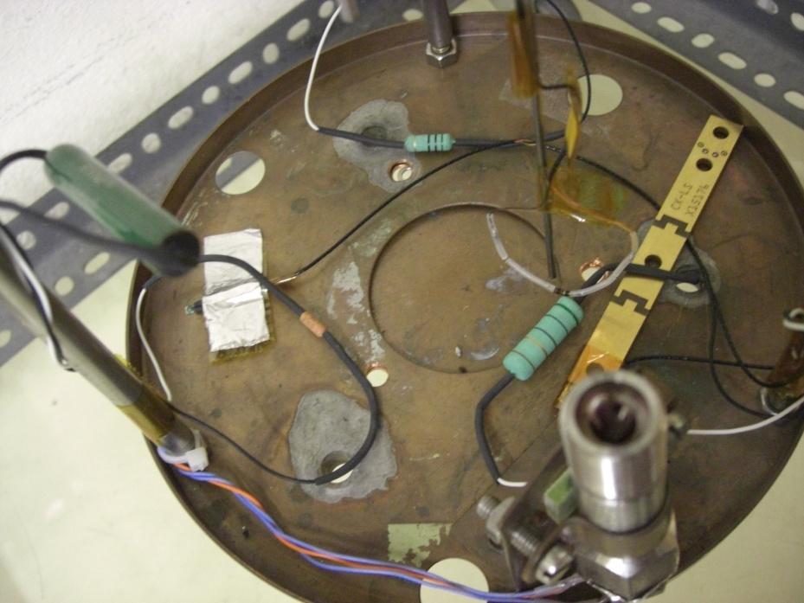
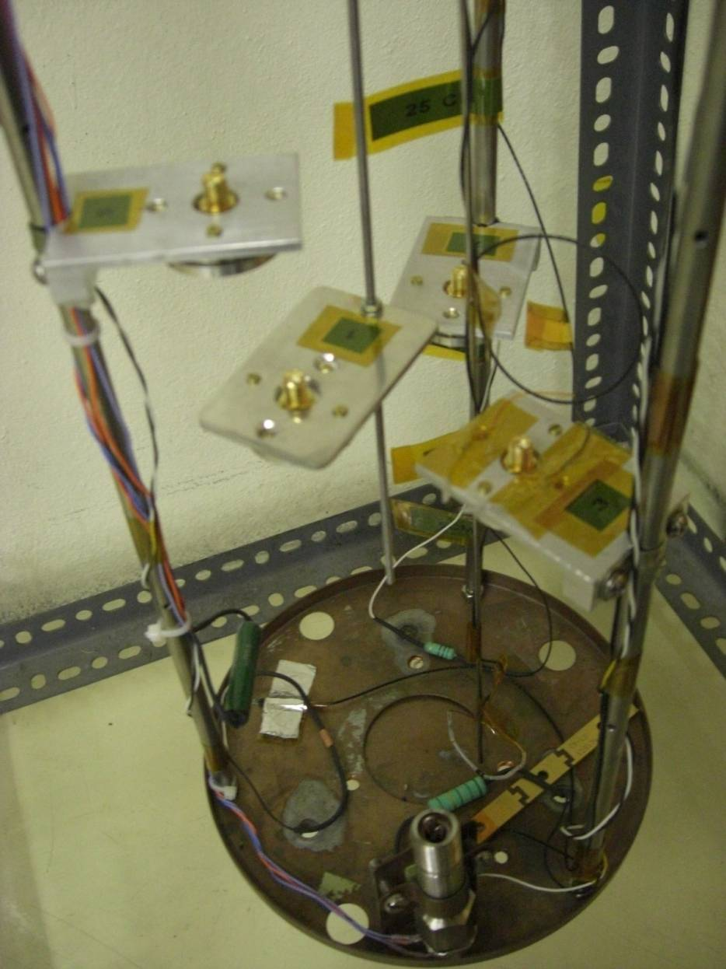
2nd sound setup @ Cryolab
I. Introduction II. 2nd sound III. Temp. maps IV. X ray V. Bubble formation VI. Summary
3 heaters
1 adjustable thermometer, 1 fixed
1 adjustable OST, 3 fixed
Metal film, 2W
Wirewound, 3W
Wirewound, 7W
(A.B) carbon resistor 100 Ω, 1/8W

Slide 8
2nd sound signal
I. Introduction II. 2nd sound III. Temp. maps IV. X ray V. Bubble formation VI. Summary
OST 1: 70pF , f=12kHz (R.T)
OST 2: 63.5pF, f=6.5kHz (R.T)
Suppress common mode hum (50Hz)
OST 1 (20 cm) - OST2 (20cm)
V= D/ Δt
=20cm/9ms
=22.2 m/s
9 ms

Slide 9
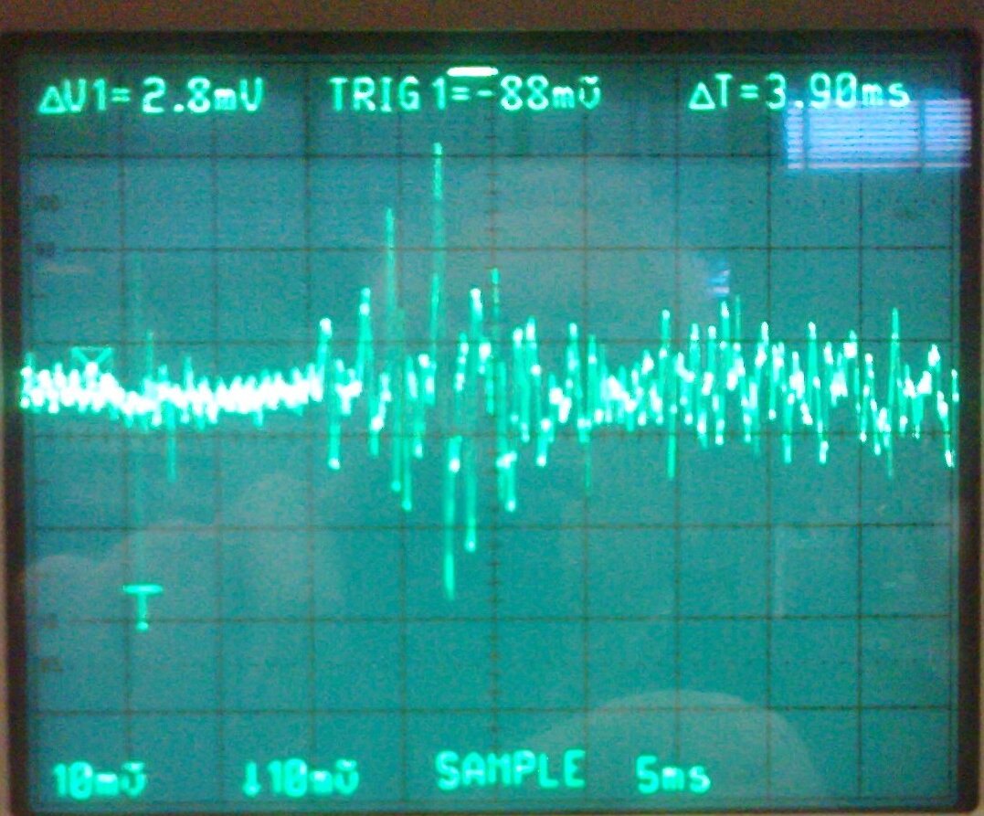
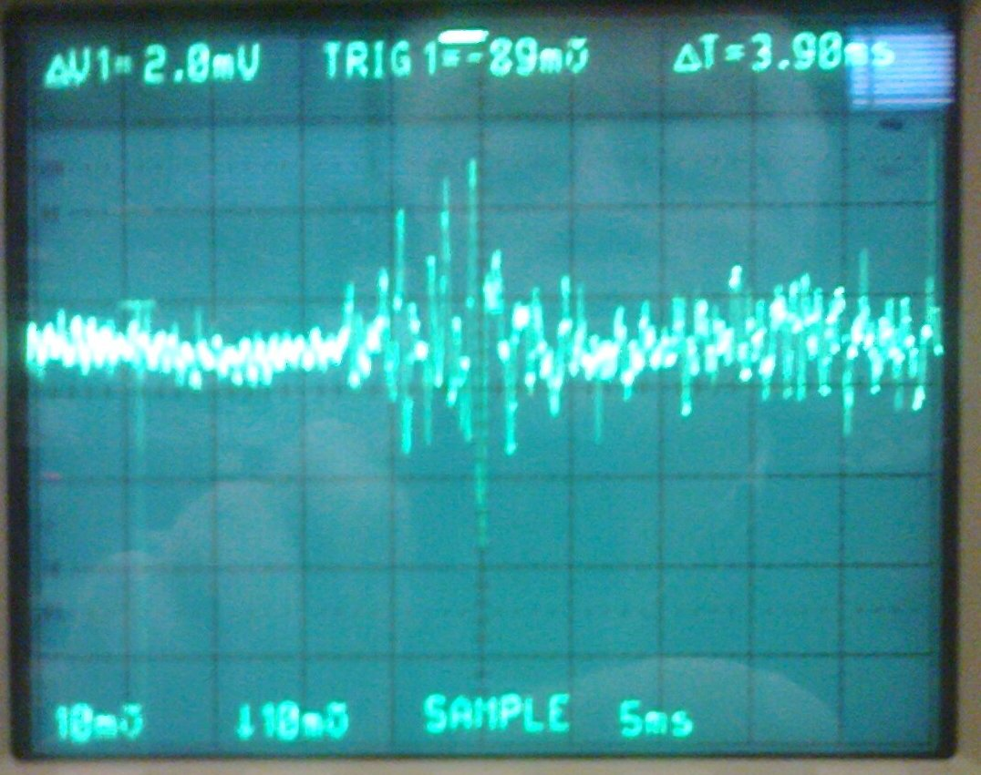
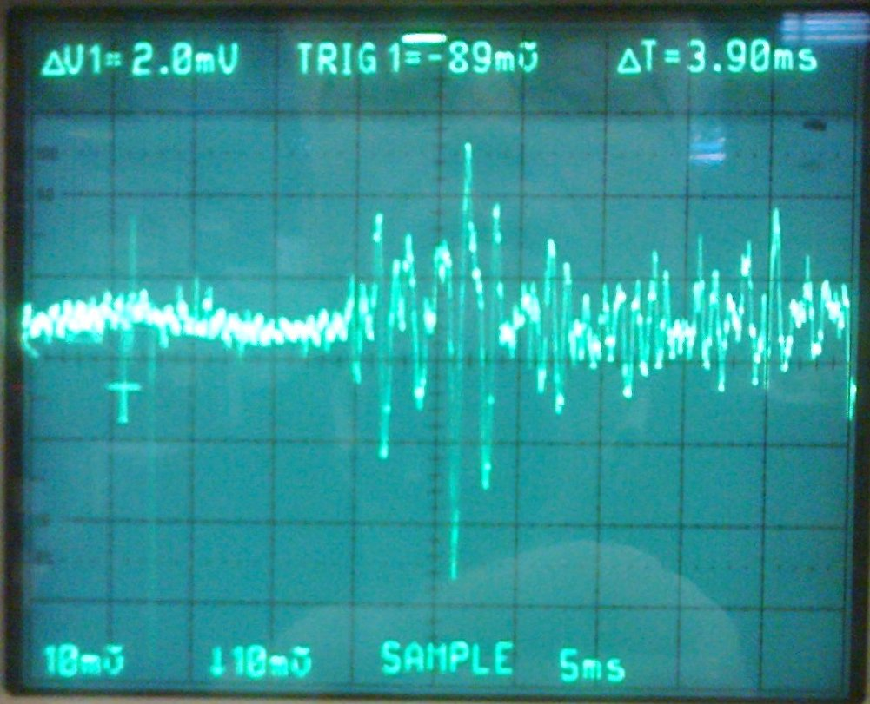
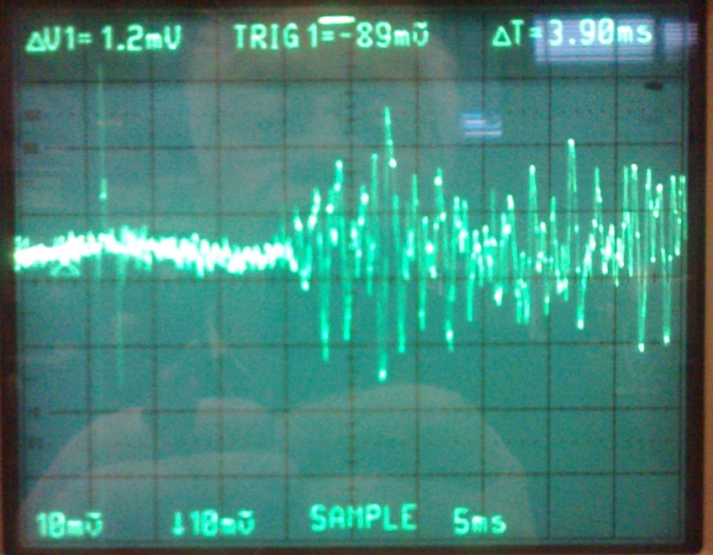
2nd sound signal
1
2
9 ms
10 ms
12 ms
13 ms
3
4
Photos taken by Wolfgang Weingarten

Slide 10
Temperature maps
I. Introduction II. 2nd sound III. Temp. maps IV. X ray V. Bubble formation VI. Summary
Field emission | quench | Precursor | Residual (loss)distribution
✓ | ✓ | ✓ | ✓
Methods:
Fixed 2. Rotating
Source: Tongu et al.
Proc. of IPAC ’10
Source: Moeller et al. Proc. of SRF09
Source: Canabal et al. Proc. of IPAC ’07
Source: Reschke, Proc. of LINAC08

Slide 11
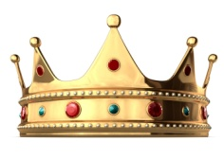
I. Introduction II. 2nd sound III. Temp. maps IV. X ray V. Bubble formation VI. Summary
Sensor selection for temperature mappings
 | Differential accuracy | Absolute precision (reproducibility) | Dimensionless sensitivity | Price per unit
Carbon resistor | ☺ | 😐 | ☺ | ☺☺
Silicon diode | ☺ | 😐 | ☺ | ☹
Cernox | ☺ | ☺ | ☺ | ☹
Germanium resistor | ☺ | ☺ | ☺ | ☹
Ruthenium Oxide | ☺ | 😐 | ☺ | ☹

Slide 12
Temperature mapping proposal
I. Introduction II. 2nd sound III. Temp. maps IV. X ray V. Bubble formation VI. Summary
1 cell test & (fast real time multiple cell measurement):
fixed scheme
Sensor strips for attachment onto the cavity walls
32 *32= 1024 sensors per cell
~5000 sensors for 5 cell, fixed board
Multiple cell test (patience needed)
rotating scheme
motor to drive the wiring arms, multiplexing circuit
Sensors:
Allen Bradley Carbon resistors
Source: Tongu et al.
Proc. of IPAC ’10
Source: Canabal et al. Proc. of IPAC ’07

Slide 13
X ray detection
I. Introduction II. 2nd sound III. Temp. maps IV. X ray V. Bubble formation VI. Summary
At high E fields, the field emitted electrons collide with the cavity wall →produce bremstrahlung.
Photodiodes (silicon) implemented along with the temperature sensors and an amplifier circuit for integration
Enable discrimination between defects and electron impact spots.
Used under all helium conditions
→Measurement of the spatial X-ray distribution : location & distribution of electron emission

Slide 14
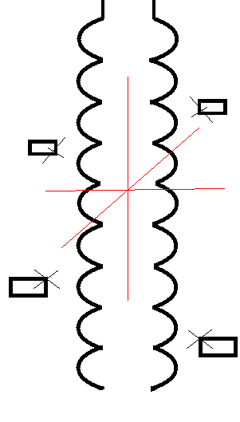
Bubble formation (nucleate boiling)
I. Introduction II. 2nd sound III. Temp. maps IV. X ray V. Bubble formation VI. Summary
around the heater area: heat accumulation→ boiling
4 Intensified charged-coupled device (CCD chip) (Extremely high sensitivity, used in night vision devices, for cryogenic use, in normal boiling He)
90 degree spacing

Slide 15
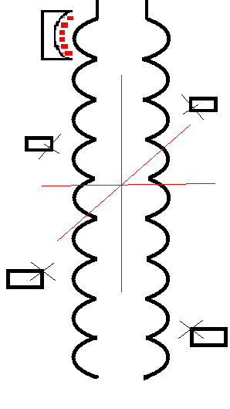
Summary
I. Introduction II. 2nd sound III. Temp. maps IV. X ray V. Bubble formation VI. Summary
Photodiodes & temperature sensors
Signal | 2nd sound | Temperature maps | X ray | Bubble formation
Equipment | OST | Fixed/ carbon resistors | Fixed/ photodiodes | ICCD camera
Thermal breakdown | ✓ | ✓ |  | ✓
Field emission |  | ✓ | ✓
Helium needs | Superfluid | Subcooled (better sensitivity) | All He | Normal boiling He
OST
Camera
Temperature sensor strips

Slide 16
Acknowledgements
OSTs by Prof. Georg Hoffstätter, Dr. Zack Conway at Cornell University, Ithaca, N.Y. , USA
TE-CRG/Cryolab: Johan Bremer and his team
Supervisor: Dr. Wolfgang Weingarten
Colleagues and former colleagues of BE-RF group

Slide 17
Q & A
Thank you very much!
Kitty.Liao@cern.ch

Slide 18
Diagnostics system for SPL cavities & 2nd sound setup @ Cryolab
Back up slides
Kitty Liao
CERN BE-RF-KS

Slide 19
Second sound extra
Helium →Lambda point 2.17K → superfluid He
2 fluid model
normal component + superfluid component
1st sound: n, s in phase
Fluctuation in density, by changes of pressure
Normal fluid
Entropy, viscocity
Bose-Einstein condensate
2nd sound: n, s out of phase
With no entropy, no viscosity
Fluctuation in density, by changes of temperature
Source: R. Donnelly. Physics today 2009

Slide 20
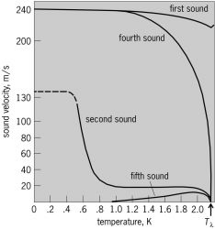
Second sound and first sound below the lambda point
First sound- pressure wave
Second sound- entropy (temperature) wave
Third sound- wave travels in very thin films of helium in which the thickness of the film varies.
Fourth sound- pressure wave travels in superfluid helium. When its confined in a porous material.
Fifth sound- temperature wave that propagates in helium confined in superleaks. (analogous to second sound)
McGraw-Hill Concise Encyclopedia of Physics. © 2002 by The McGraw-Hill Companies, Inc.

Slide 21
Defects diagnostics method | Sensor type | Temperature range | Sensitivity | Performance in Magnetic field | Mechanical layout | Multiplexing
Fixed ( 1 cell) | Carbon (Allen-Brad.) | 1K-100K | with 10mK resolution | Small M field dependence |  | No
Fixed (9 cell) | Carbon (Allen-Brad.) | 1K-100K | 0.186mV/mK at 2 K |  |  | Yes
Fixed | Silicon diode | 1.4K-500K | Nearly constant 2.3mV/K (S_{D}=-0.01 at1.4K) | Fair above T>60K |  | Yes, but not separate
High density (fixed strips) | Ruthenium Oxide (RuO₂) | 0.01K-40K | Negligible for T>40K (S_{D}~-0.07) S_{D}~-0.5 at 1.4K | Good below 4K |  | Yes (CMOS)
Rotating *** | Carbon resistors | 1K-100K | <5mK | Small M field dependence |  | -many cables that move around
Fast thermometry (equator & iris) | CernoxTM | 0.10K-325K | S_{D}=-1.6 at1.4K | Excellent above 1K |  | No, few cables
I. Introduction II. 2nd sound III. 1st sound IV. Temp maps V. X ray VI. Bubble formation VII. Summary

Slide 22
Sensor selection for temperature mappings
 | Temperature range |  | Accuracy | Dimensionless sensitivity dR/R x T/dT |  |  | Price per unit
 | Low High |  |  | 1.4 | 4.2 | 20
Silicon diode** | 1.4K | 325K | ±20mK(<10K); 55mK (10K~475K) | -0.01 | -0.09 | -0.29 | USD$ 100~300
Cernox | 0.3K | 420K | ±5mK (4,2K) | -1.6 | -0.9 | -0.59 | USD$ 100~300
Germanium resistor | 0.1K~1.4K | 40K~100K | ±5mK (<10K) | -0.93~ -3.9 | -0.73~ -2.6 | -0.62~ -2.4 | USD$100~300
Ruthenium Oxide (for cryogenic use) | 0.05K | 40K | ±13mK (4.2K) | -0.47 | -0.25 | -0.07 | USD$ 100~300
Adapted from Lakeshore datasheet document

