Slide 1
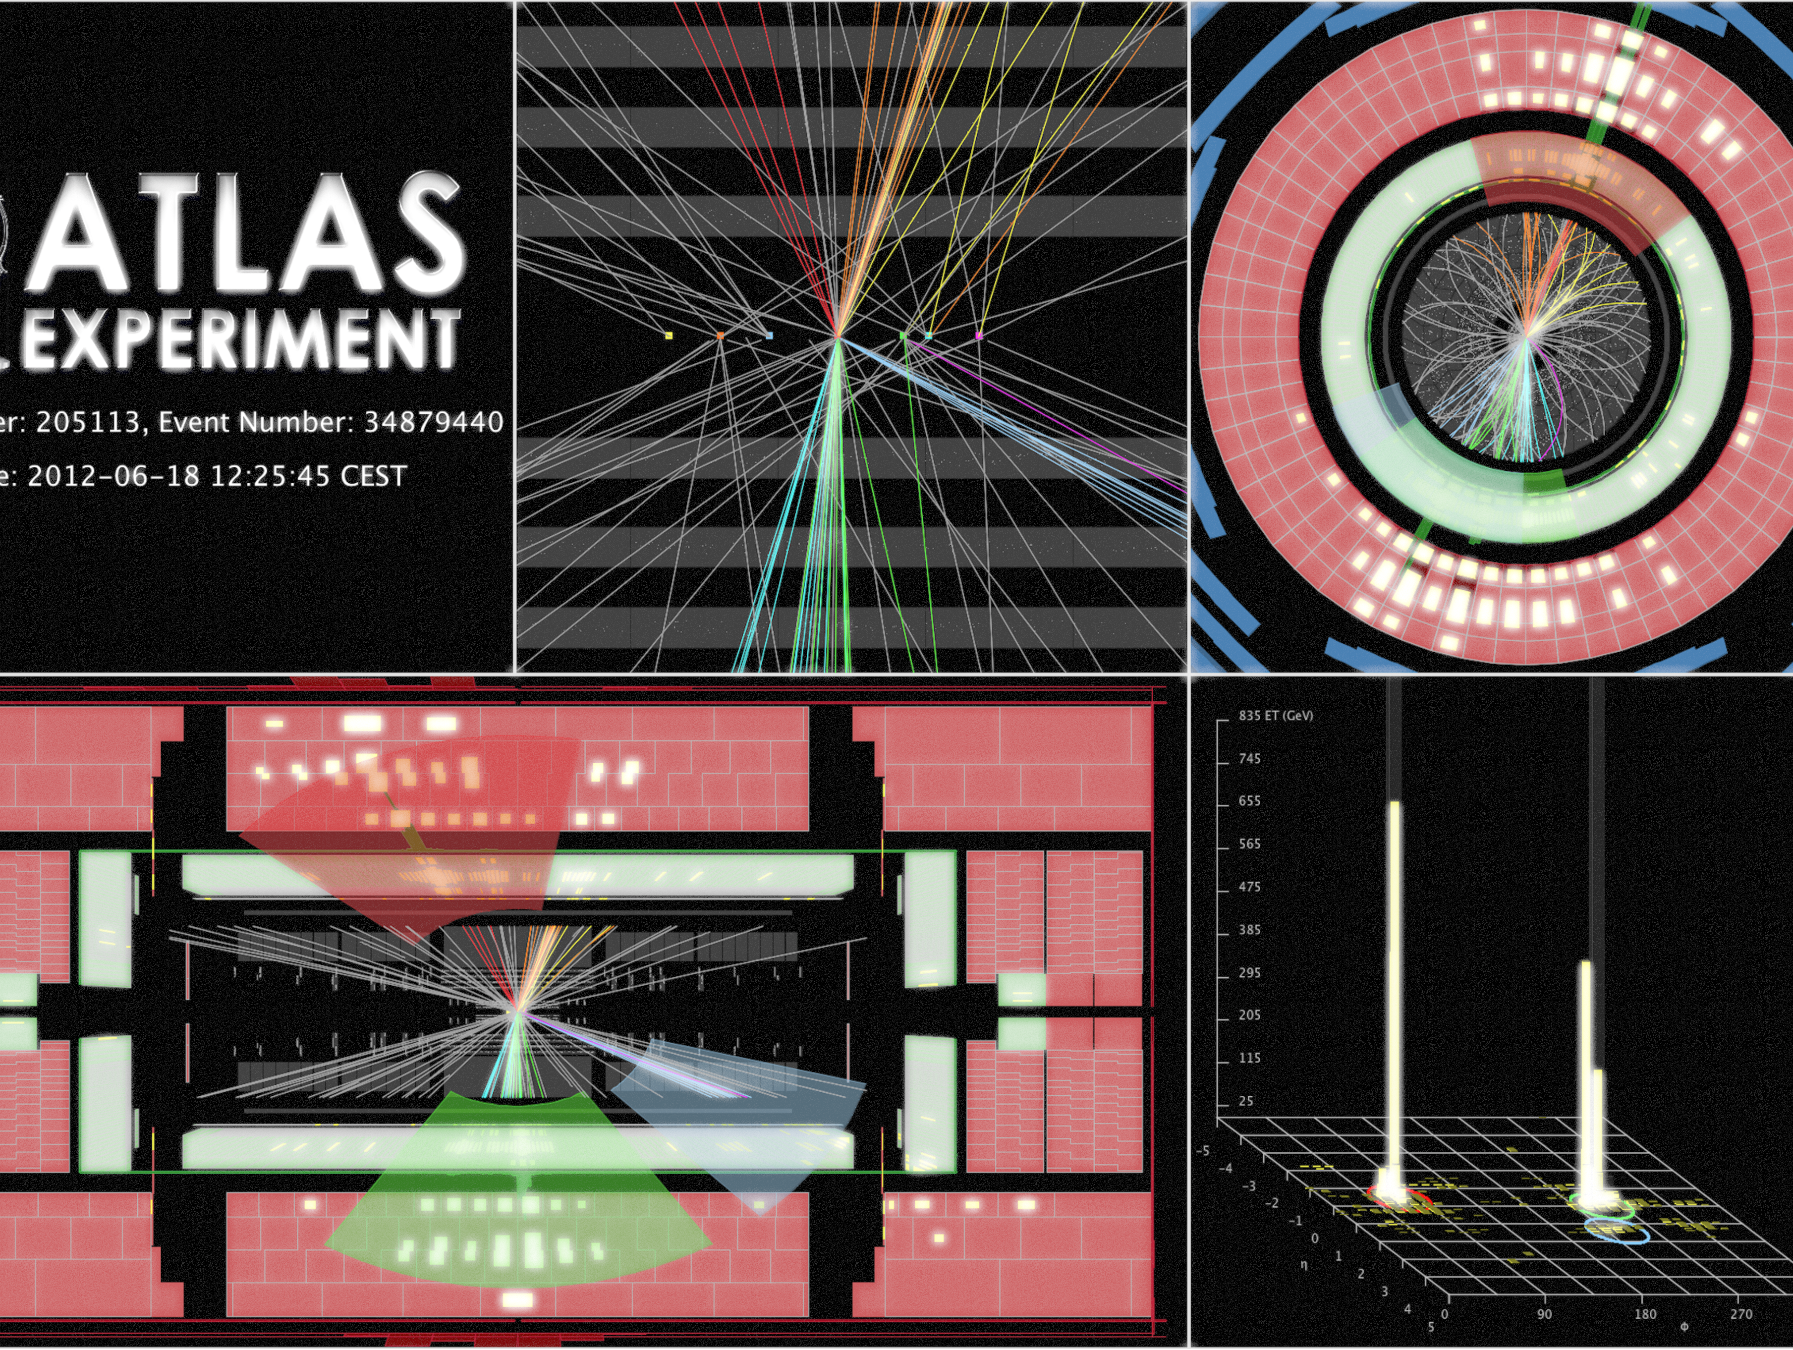
Boosted Top Jets:
Precision Measurements of Top Quark Pair Production
Pekka K. Sinervo, FRSC
Department of Physics
University of Toronto
24 Apr 2018

Slide 2
Outline
Introduction to Boosted Top Quarks
QCD and Top Jets
Top and Bottom Tagging Algorithms
Differential Cross Section Measurements
Summary & Conclusions

Slide 3

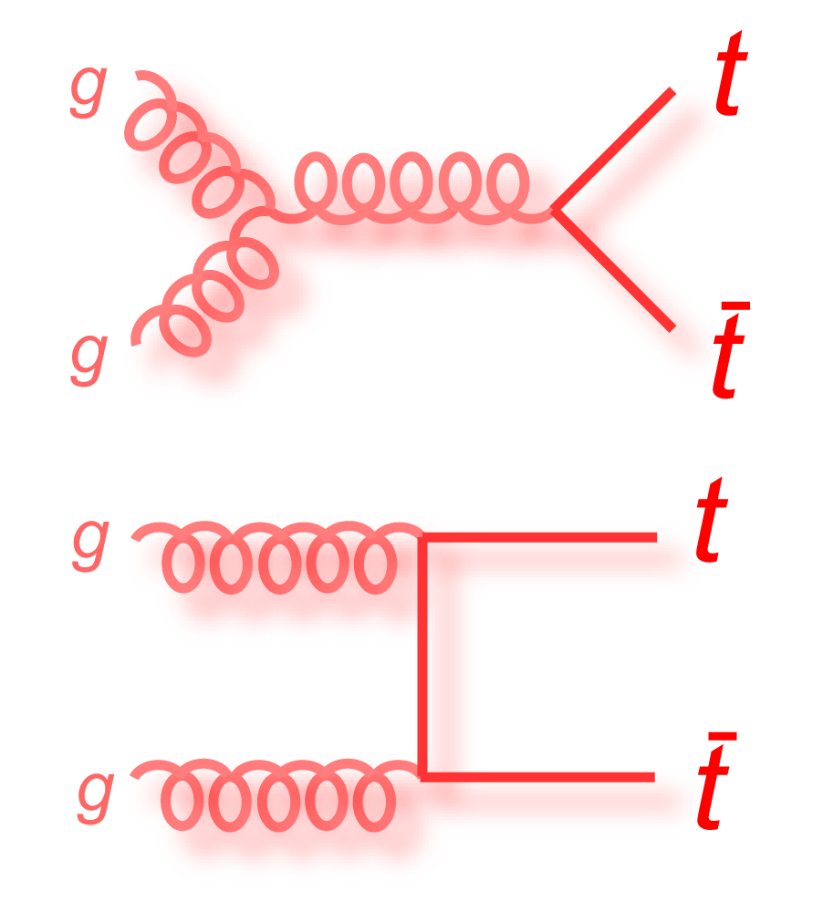
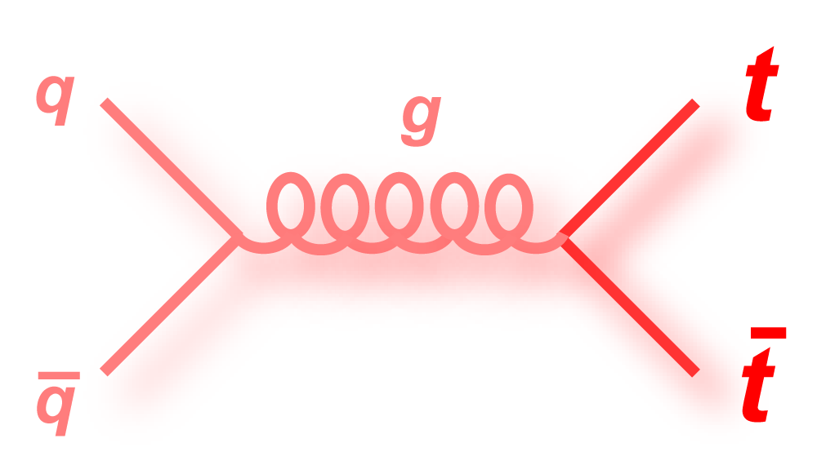
The Top Quark
Unique role
  Heaviest particle
  In SM, strongest coupling to Higgs boson
  A unique role in various extensions
QCD makes precise predictions for production
  NNLO predictions exist

Slide 4
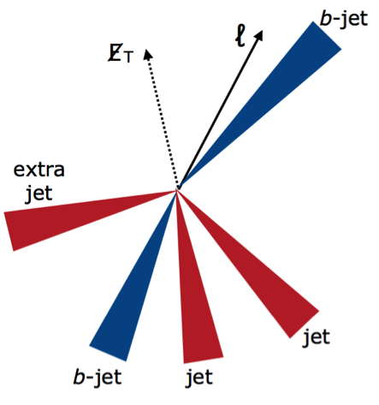
Top Quark is Special
Properties
  Most massive fermion
  Decays before hadronization
Large mass also a challenge
  Decay products are energetic
  Difficult to reconstruct top quark decays in pair production
Incandela, Quadt, Wagner & Wicke, Prog.Part.Nucl.Phys.63:239-292,2009

Slide 5
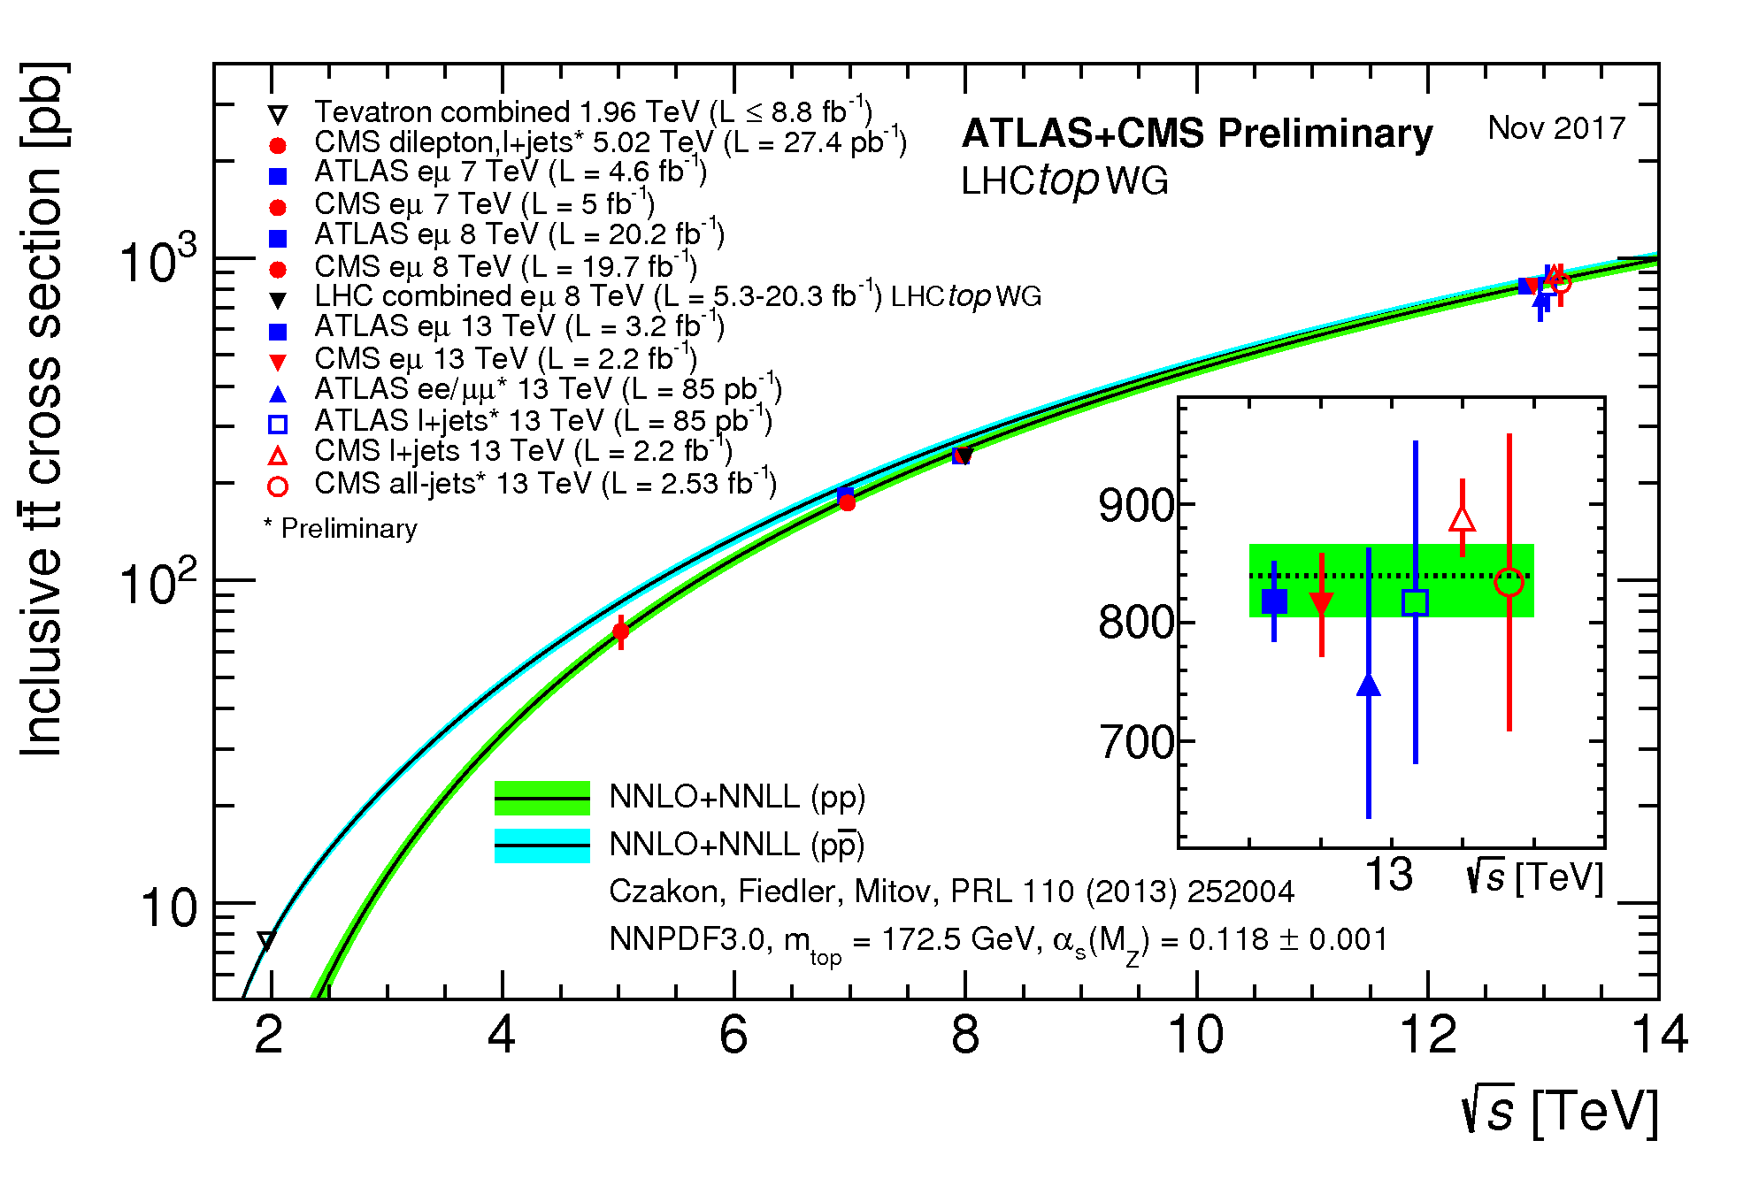
What Are Boosted Top Quarks?
Top quark pair production ubiquitous at LHC
σ = 832 ± 51 pb
At 10³⁴ cm⁻² s⁻¹,
this gives a
top quark every
few seconds
Boosted top quarks
are those with
  p_{T} ≳ 500 GeV
Rare – 0.1% of total
LHC TOP WG

Slide 6
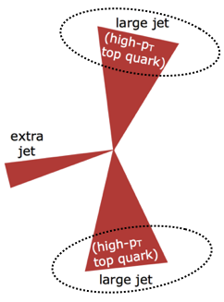
Top Quark Pair Production
Each top quark decays weakly
  3 possible final states
Focus on the “all-hadronic” mode
  44% of all decays
  No undetected particles!
  At high p_{T}, top quark decay reconstructed as a “top jet”

Slide 7
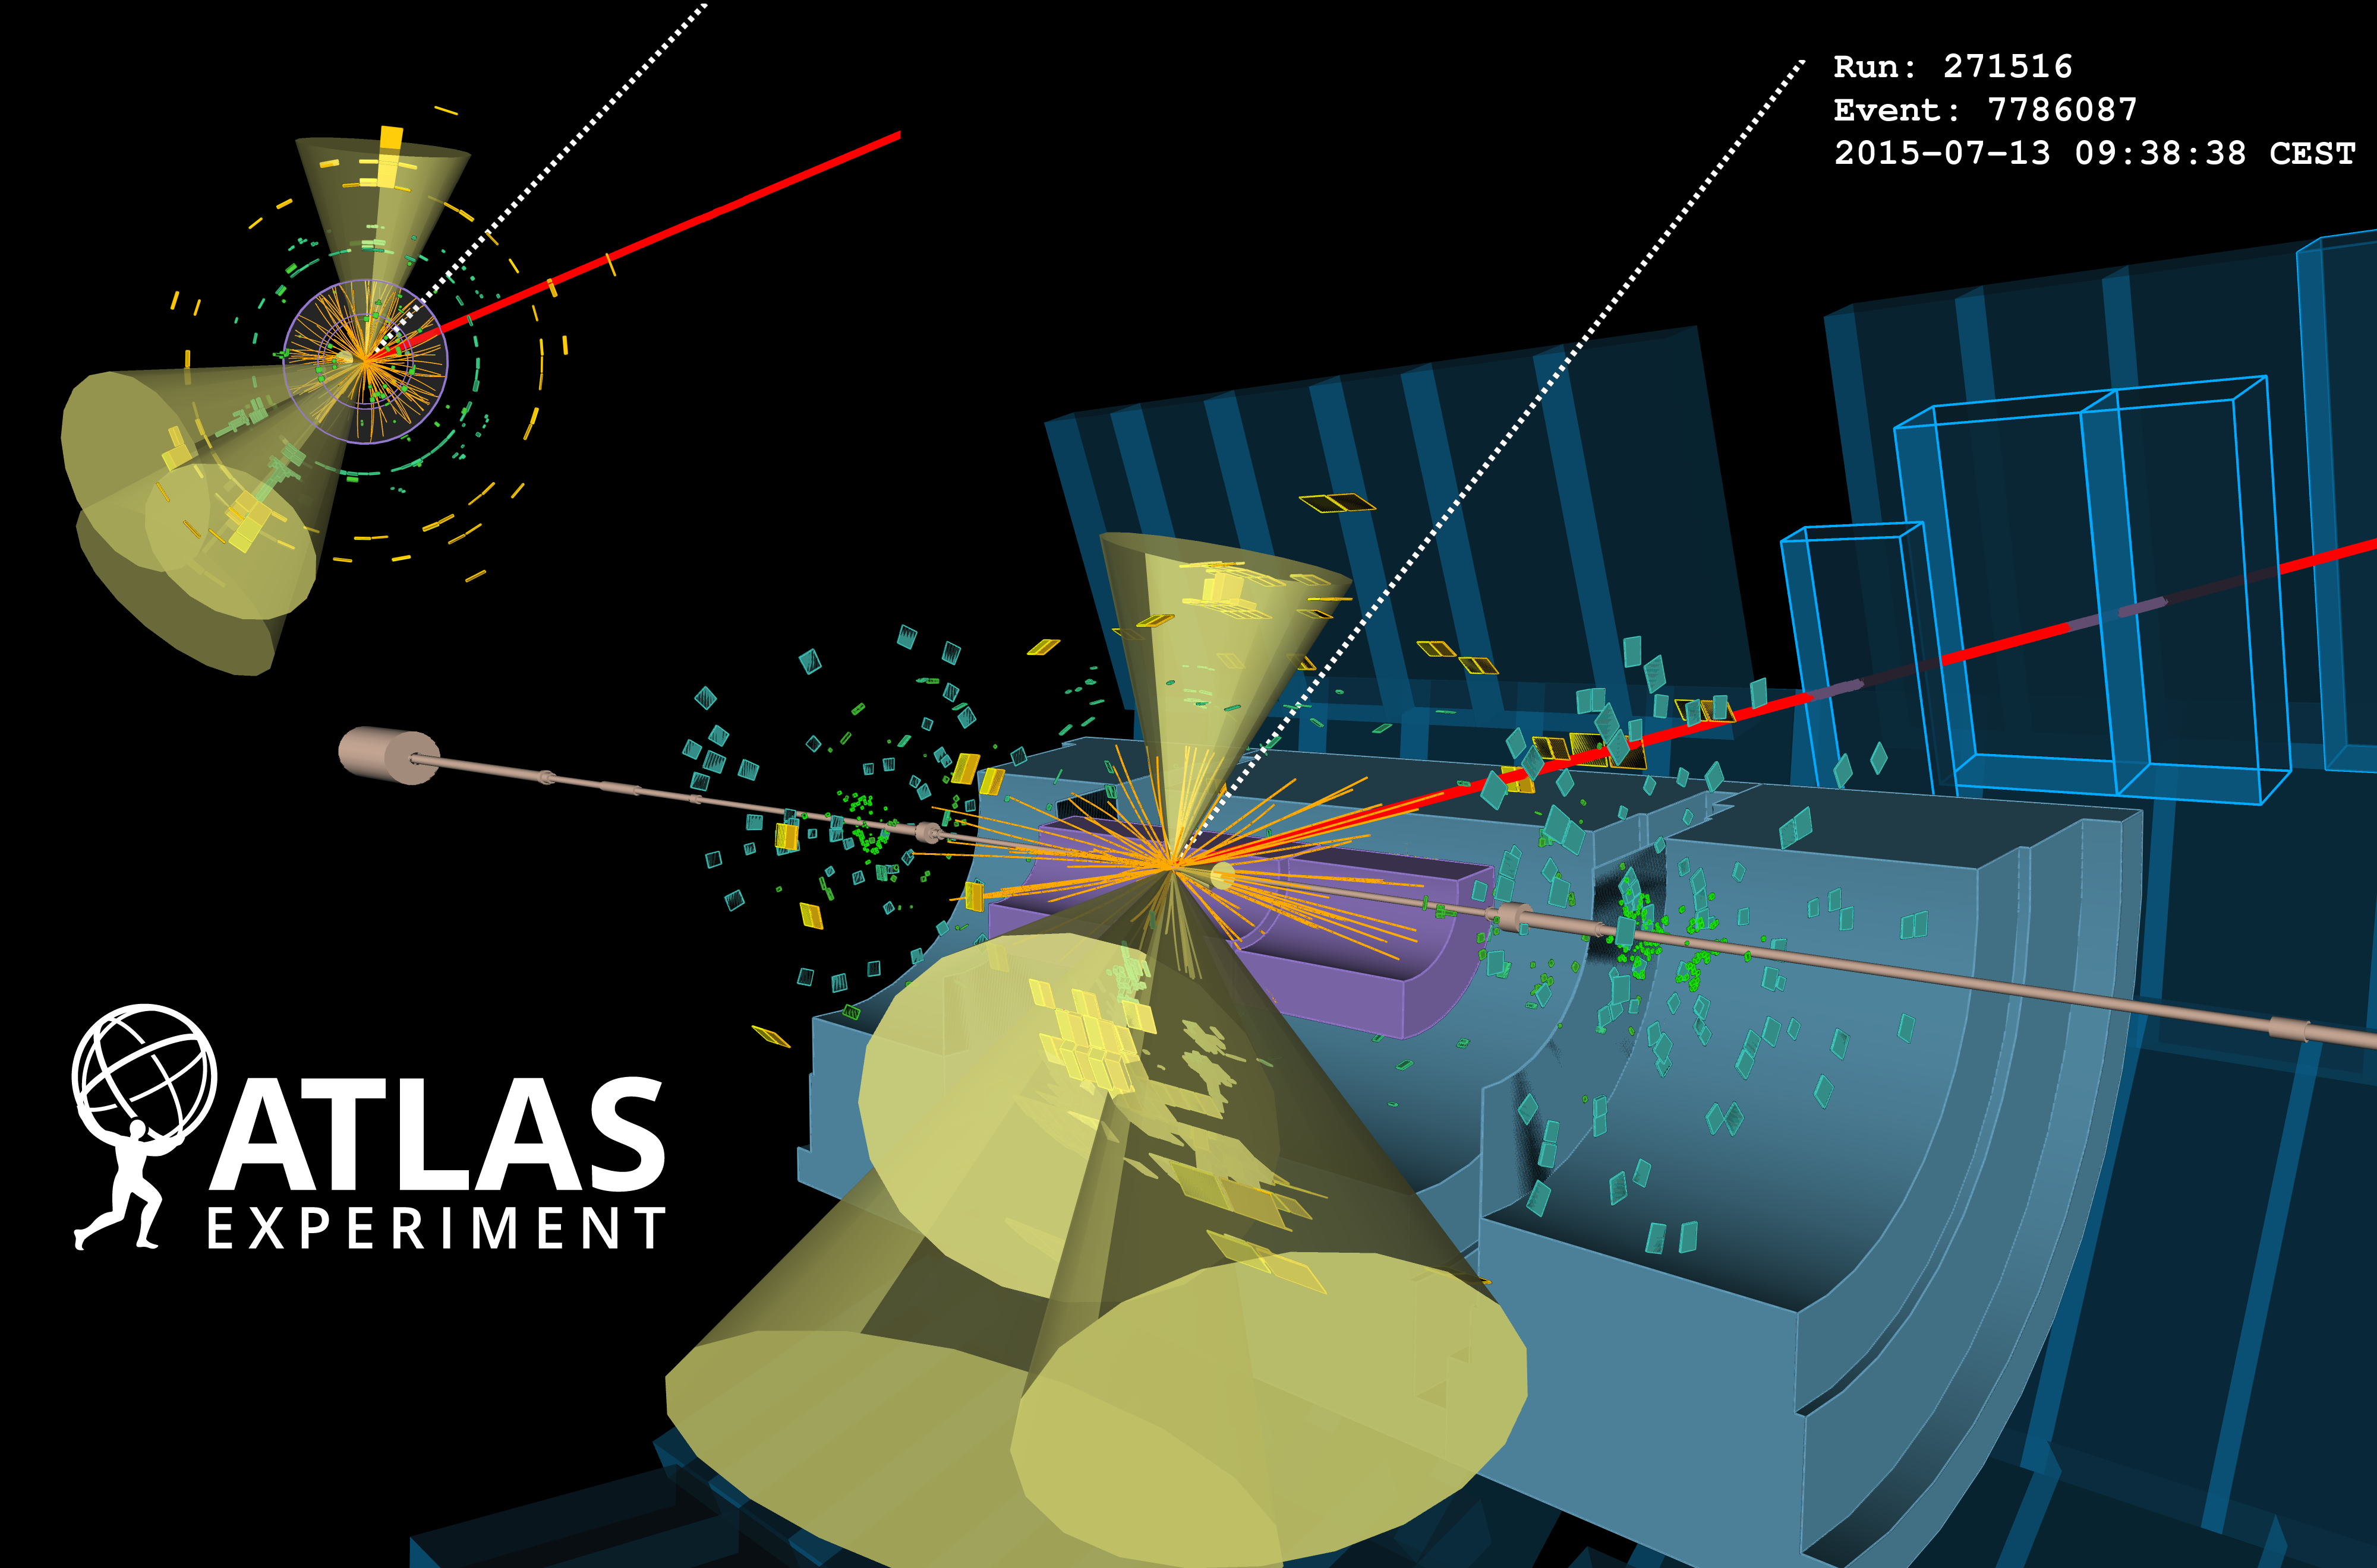
A Very high-P_{T} Top
Muon + Missing E_{T} 470 GeV
3 R=0.4 jets
3 jets with p_{T}= 600 GeV,
jet mass=180 GeV
Recoiling jet b-tagged

Slide 8
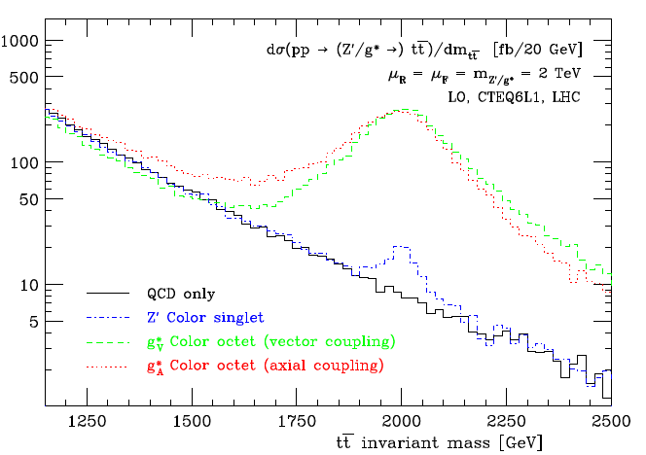
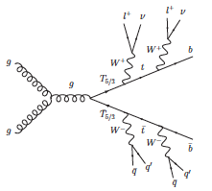
Why the Interest in Boosted Tops?
Top quarks play a special role in many models for new physics, eg.
Couple to new force carriers
  Leptophobic Z’ preferentially decays to top quark pairs
  W’ bosons could decay to t-b pair
String-inspired resonances
  Randall-Sundrum KK gluons/gravitons (g_{KK,}G_{KK}) favourite “wide” resonance
New phenomena
  Vector-like top quark partners
  Supersymmetric top partners
Rosner, PLB 387 (1996) 113
Agashe et al., PRD 77, 015003 (2008) ;
Lillie et al., JHEP 09 (2007) 074
Fredrerix & Maltonii, JHEP 01 (2009) 047
Agular-Saavedra et al, PRD 88, 094010 (2013)

Slide 9
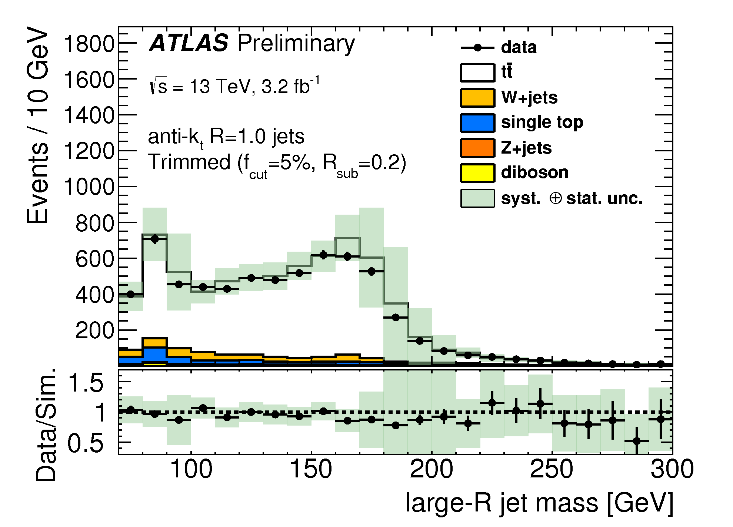
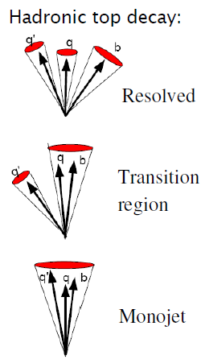
Strategies for Detection
Two strategies for identifying boosted top quarks
Semi-leptonic top quark decays
Fully-hadronic decays
Focus on the second
  Largest BR (2/3)²
  No missing particles
  All decay products collimated
  Require understanding
  of multijet background
Top p_{T} > 300 GeV
ATLAS-JETM-2015-004
Long list of references….

Slide 10

CERN Large Hadron Collider
LHC collides protons at 13 TeV
High luminosity
  2800 bunches
  1.2 x 10¹¹ protons per bunch
  Bunch crossings every 25 ns
  L > 10³⁴ cm⁻² s⁻¹

Slide 11
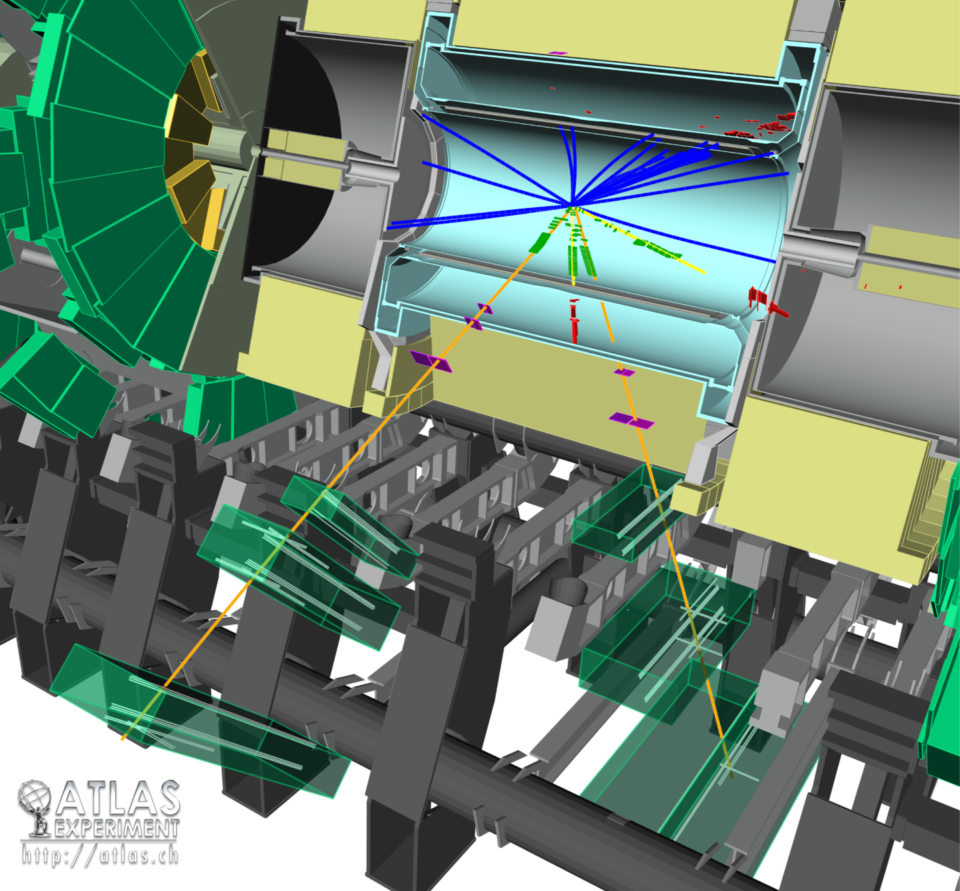
The ATLAS Detector

Slide 12
LHC Data Taking
LHC has run well at 13 TeV
13 TeV data:
3.9 fb⁻¹ in 2015
32 fb⁻¹ in 2016
35 fb⁻¹ in 2017
Collision ”pile-up”
continued to increase

Slide 13
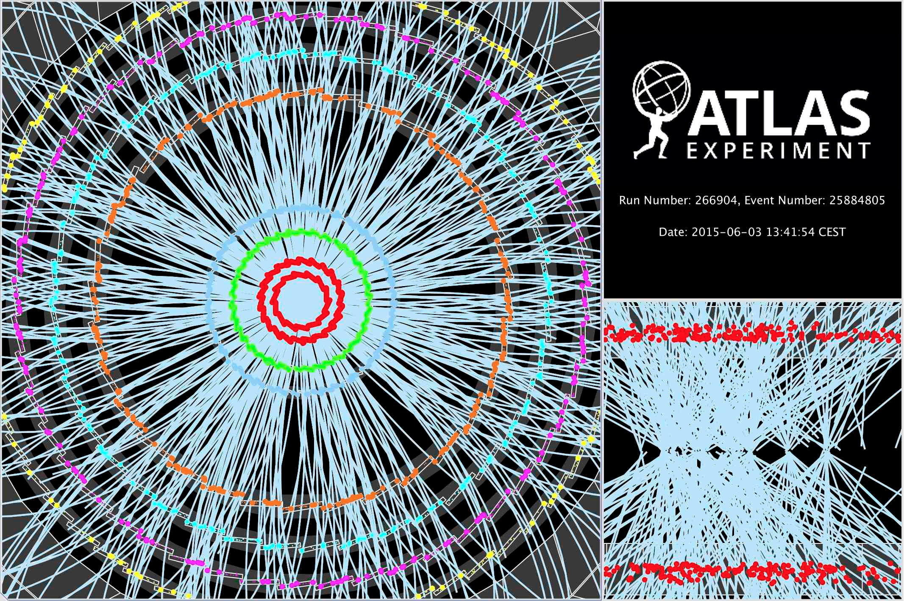
We believe there were 17 collisions…

Slide 14
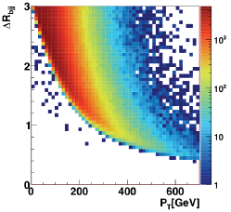
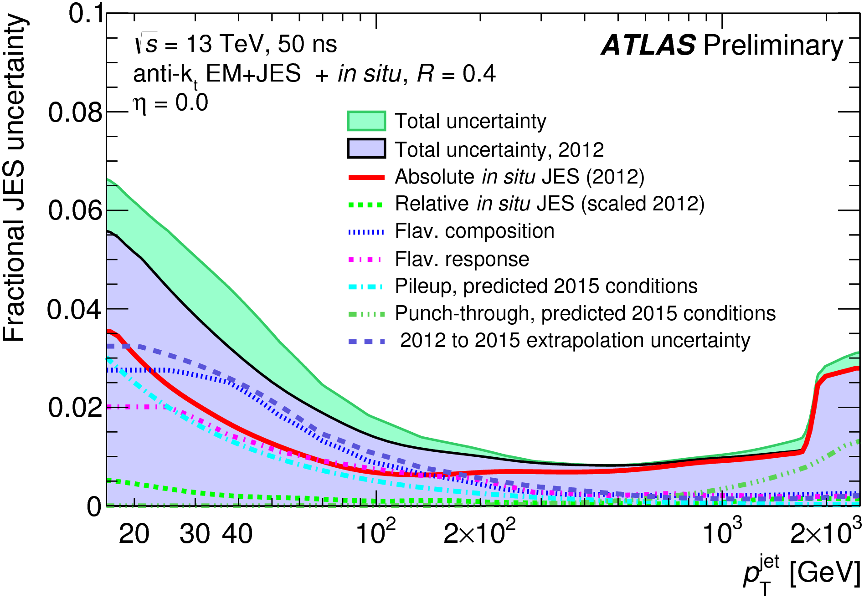
High p_{T} Top Jets
High p_{T} top decays seen as single jet
Use Anti-kt jet algorithm
  R=1.0 to capture top decay products
  But sensitive to pile-up
Calibrate energy and
mass scales using
in situ techniques
ATLAS-PUB-2015-015

Slide 15
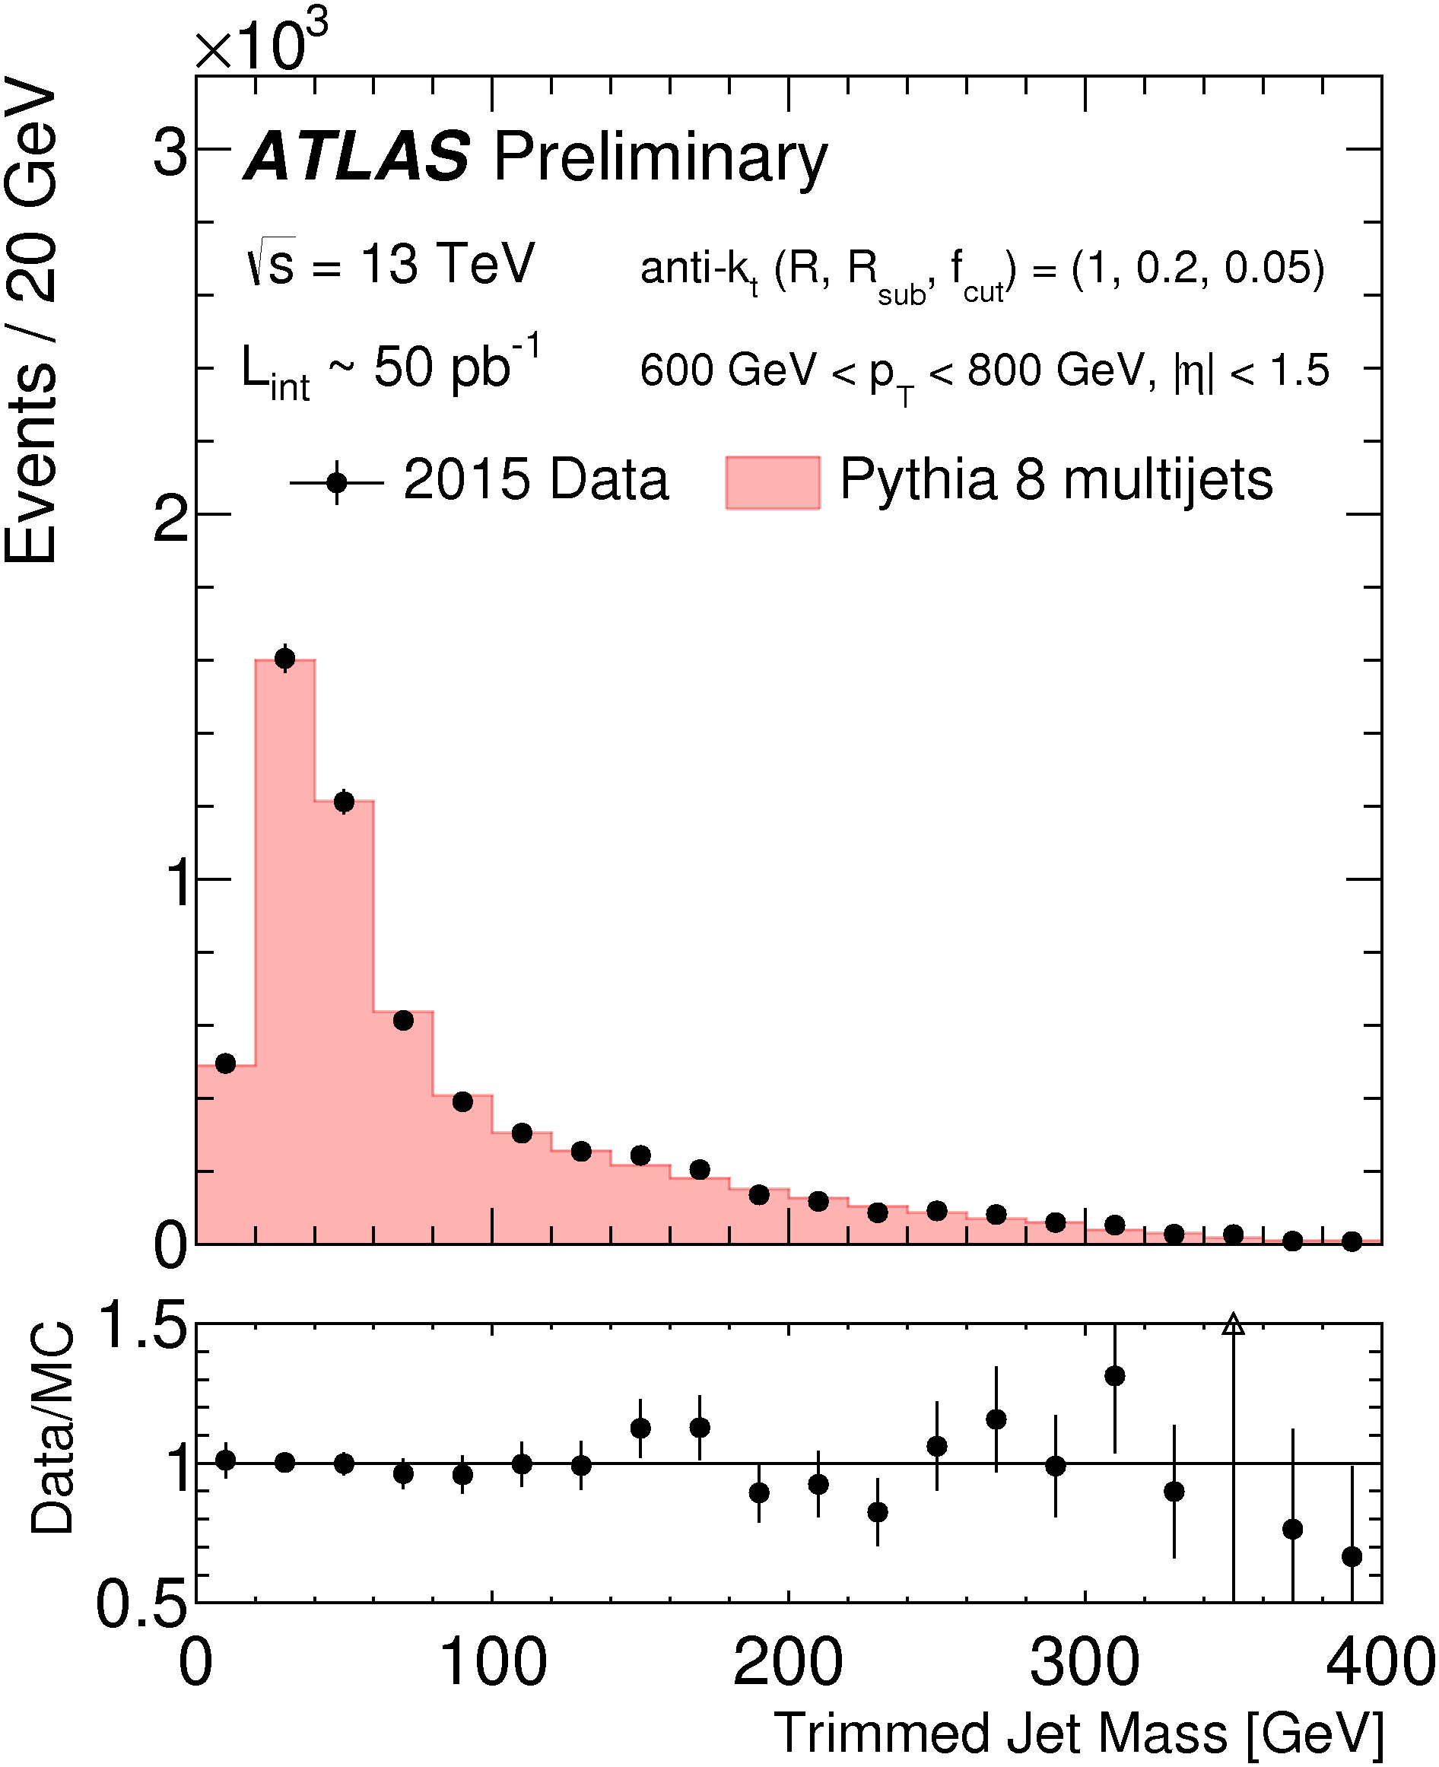
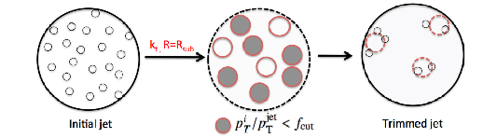
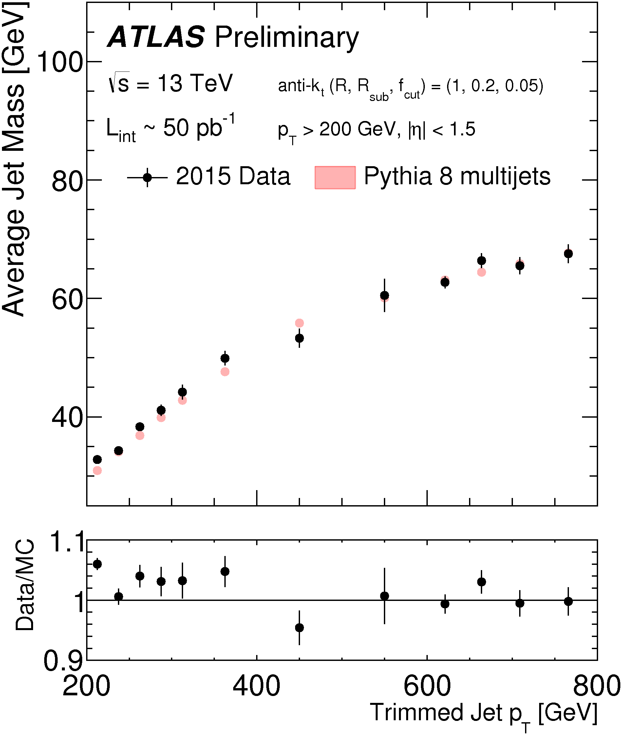
Jet Trimming
Pile-up is removed using “trimming”
Anti-kT cluster with R=1.0 – p_{T}^{R1.0}
Anti-kT cluster constituents into R=0.2 “subjets”
Keep subjets with pT > 0.05 p_{T}^{R1.0}
Recombine and re-calibrate
Takes care of pile-up
Also “suppresses”
Sudakov peak
Rises slowly with jet p_{T}
ATLAS-CONF-2015-035

Slide 16
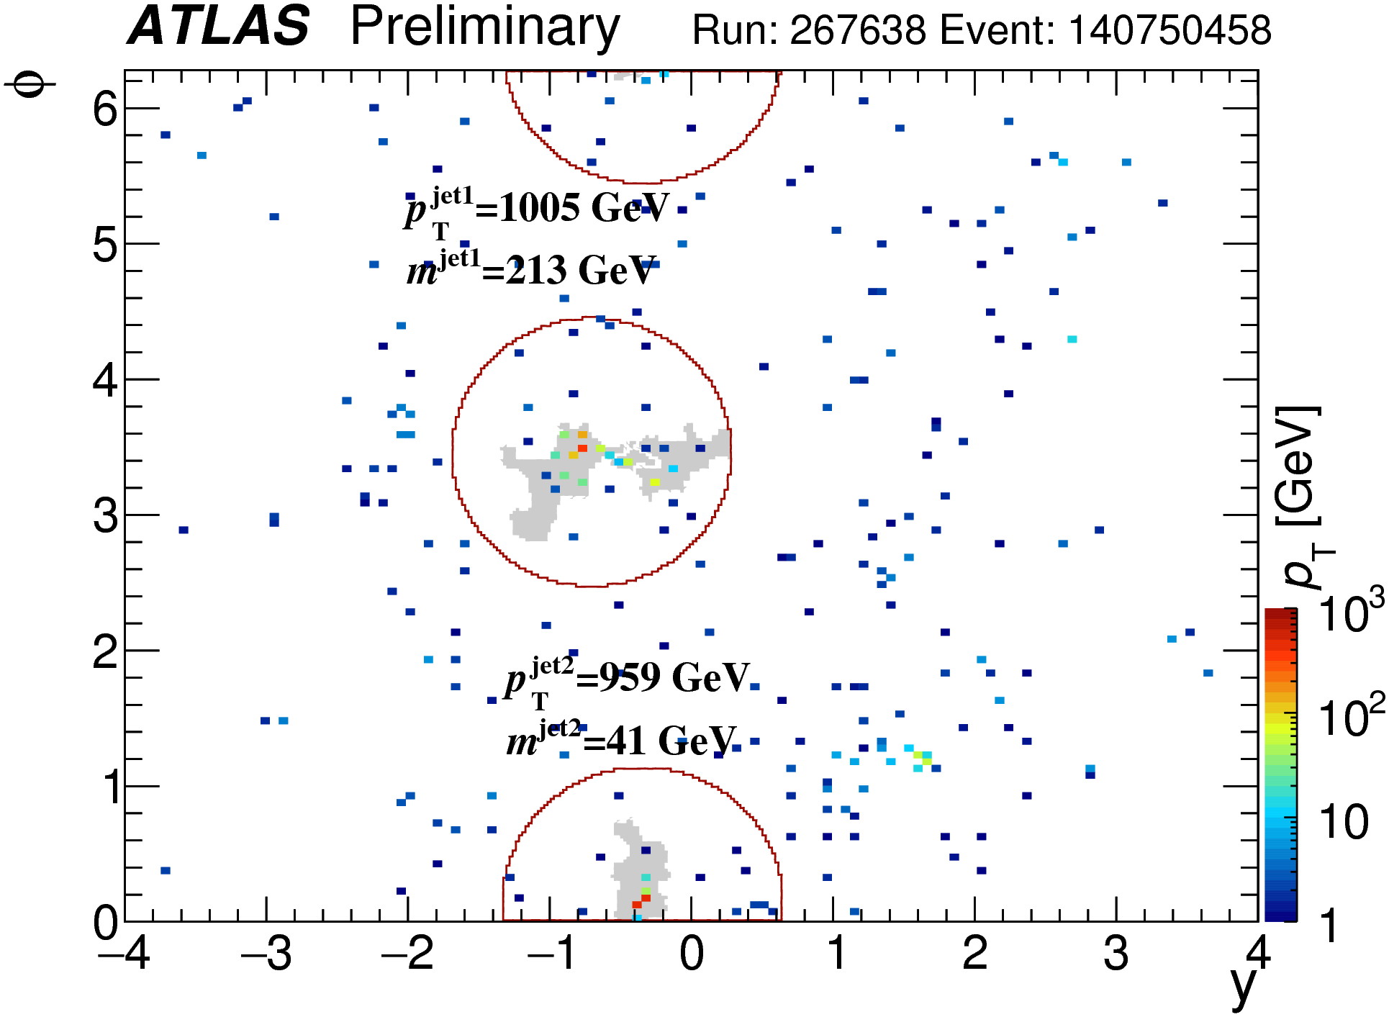

Slide 17
Jet Mass Isn’t Everything
Top quark decays are 3-prong
Light quark and gluon jets with high mass largely single gluon emission
Many strategies considered
Eight algorithms compared in ATLAS-CONF-2015-036
Taken a simple approach
for “top-tagger”
  N-subjettiness measure τ₃₂
  Jet mass cut (122 < m_{jet} < 222 GeV)
Thaler & van Tilburg, JHEP 03 (2011) 015; JHEP 02 (2012) 093

Slide 18
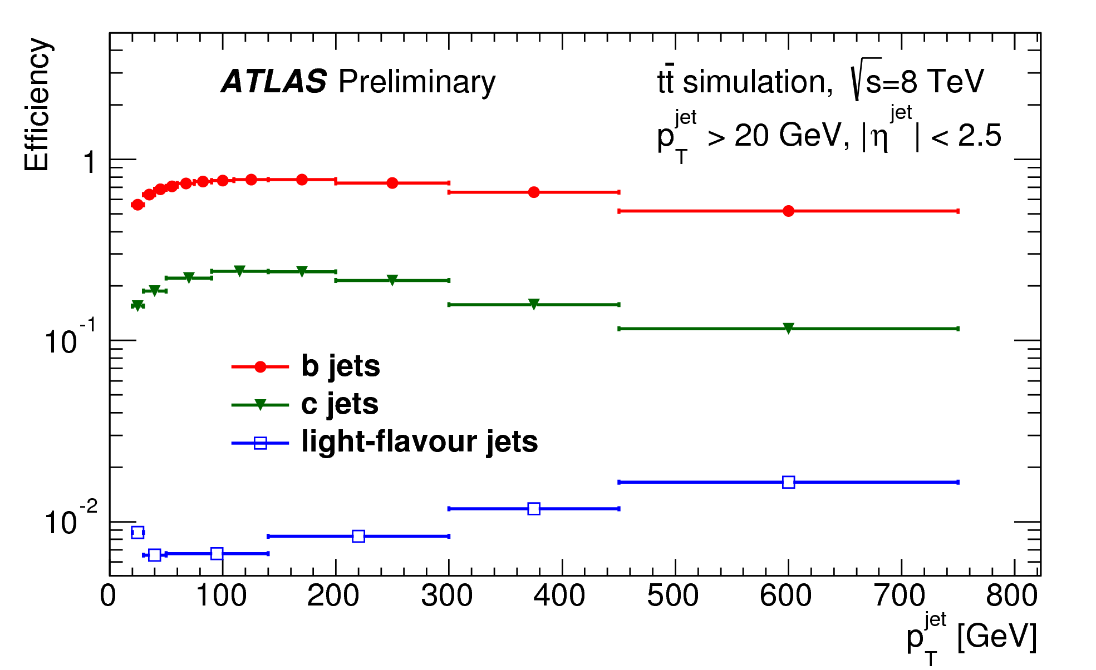
B Tagging Algorithms
ATLAS uses a multivariate algorithm to tag “b-jets”
Combination of tracking, vertex and kinematic information
Usual operating point of 70% efficiency, <1 % mistag rate
Require R=0.4
b-tagged jet
associated with
top quark jet
Essential element of
tagging strategy

Slide 19
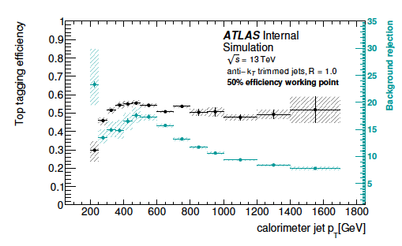
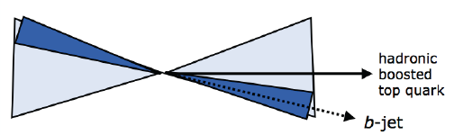
Tagging Pairs of Top Jets
Put together top-tagging
and b-tagging
Require two R=1.0 jets
  p_{T1} > 500 GeV and p_{T2} > 350 GeV
  Require both are top-tagged
  Require both have R=0.4 subjet that is b-tagged
Reject events with at least one electron or muon candidate

Slide 20
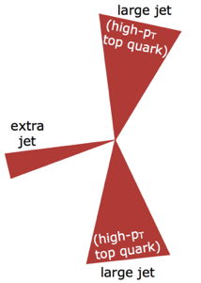
Estimating Backgrounds
Strategy
  Use MC for backgrounds with at least one real top quark jet:
  Use data to estimate “multijet” background

Slide 21
What the Signal Looks Like
Jet mass is best diagnostic
  Clear top jet peak
  Background is flat

Slide 22
Kinematics of Events
Event properties
  Rapidly falling vs p_{T}
  Back-to-back pair production
  Centrally produced
Affected by acceptance & efficiency
Correct by ”unfolding” distributions
Measure normalized differential cross sections vs. 13 variables

Slide 23


Slide 24
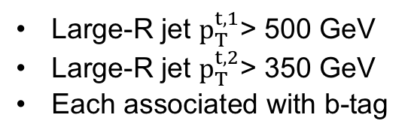
Unfolding to Particle Level
Define a ”fiducial phase space”:
Use a Bayesian unfolding procedure to correct for acceptance & efficiency
Large-R jet $p_{T}^{t,1}$> 500 GeV
Large-R jet $p_{T}^{t,2}$> 350 GeV
Each associated with b-tag

Slide 25
Systematic Uncertainties
Estimate systematic uncertainties
  Based on studies of data samples
  Modelling uncertainties come from MC comparisons
  Incorporated using
  Bayesian priors

Slide 26
Total Cross Section Measurement
Compare with different matrix-element calculations
  POWHEG
    Pythia v8 parton shower + hadronization
    Herwig v7 parton shower + hadronization
  MG5_aMC@NLO
    Pythia v8 parton shower + hadronization
    Herwig v7 parton shower + hadronization
  SHERPA 2.2.1

Slide 27
Unfolding Results: Leading Top Jet

Slide 28
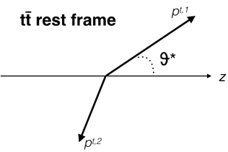
Unfolding Results: Cosθ* & m^{tt}

Slide 29
Unfold to Parton-Level
Repeat the procedure, unfolding to parton-level
Allows for direct comparison with NLO and NNLO calculations

Slide 30
Compare with Theory Predictions
Generally good agreement
Several differences in differential cross sections
  Rapidity distribution of top jets broader
  p_{T} of top-pair system softer
  χ^{tt} distribution

Slide 31
Perform 1-D chisq Tests

Slide 32
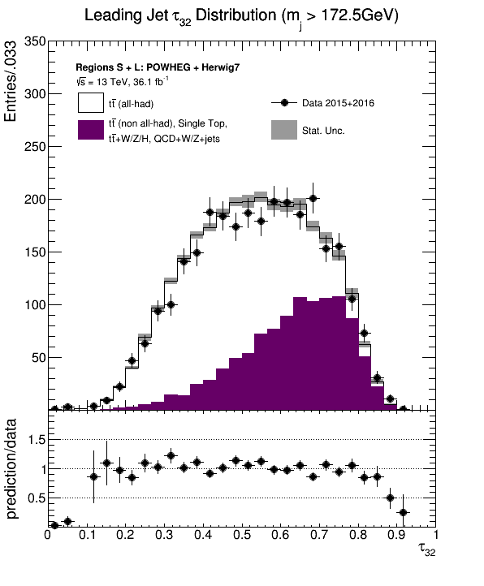
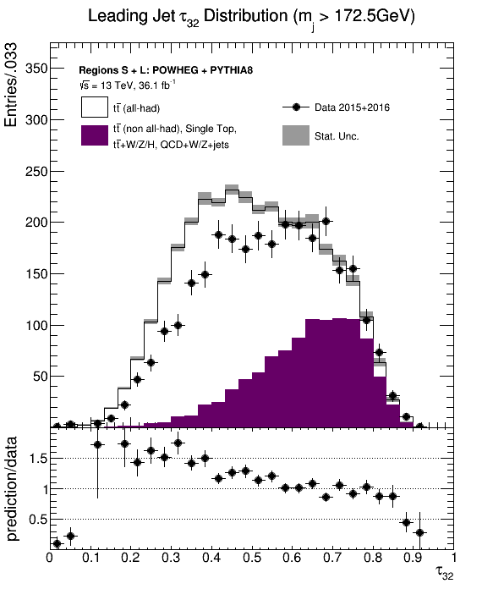
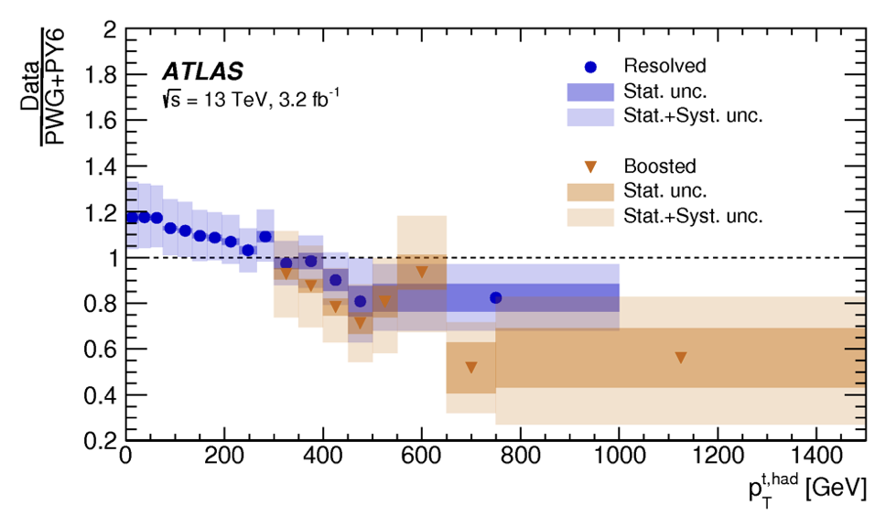
More Observations
Efficiency sensitive to hadronization – 10-15%
  Discovered that τ₃₂ most sensitive
  Directly affects the efficiency of top-tagging
Models predict harder top jet spectrum
  Confirms measurements
  at lower p_{T}
JHEP 11 (2017) 191

Slide 33
Moving to Greater Precision
Increase data sample
  Working with 2017 data
  → x2 increase
  Started collisions last week
  → another x2?
  Measure doubly-differential cross sections
Systematic uncertainties
  B-tagging – using top mass as a tool to constrain uncertainty
  Parton-shower & hadronization
    Exploring the difference in models
    Improve the models and/or make tagging less sensitive to differences?
  ME modelling
    Ongoing effort with MC developers to understand POWHEG and aMC@NLO differences

Slide 34
Summary and Conclusions
Completed first differential cross-section measurement using boosted top jets
Exploring mass scales > 2 TeV
Revealed generally good agreement with QCD predictions
Softer production than expected
More top pairs at large angles
Discriminating between theory predictions
Focuses activity on understanding physics differences
Expect to make improved measurements over next 2 years
Submitted to PRD: arXiv:1801.02052

Slide 35

BackUp Stuff

Slide 36
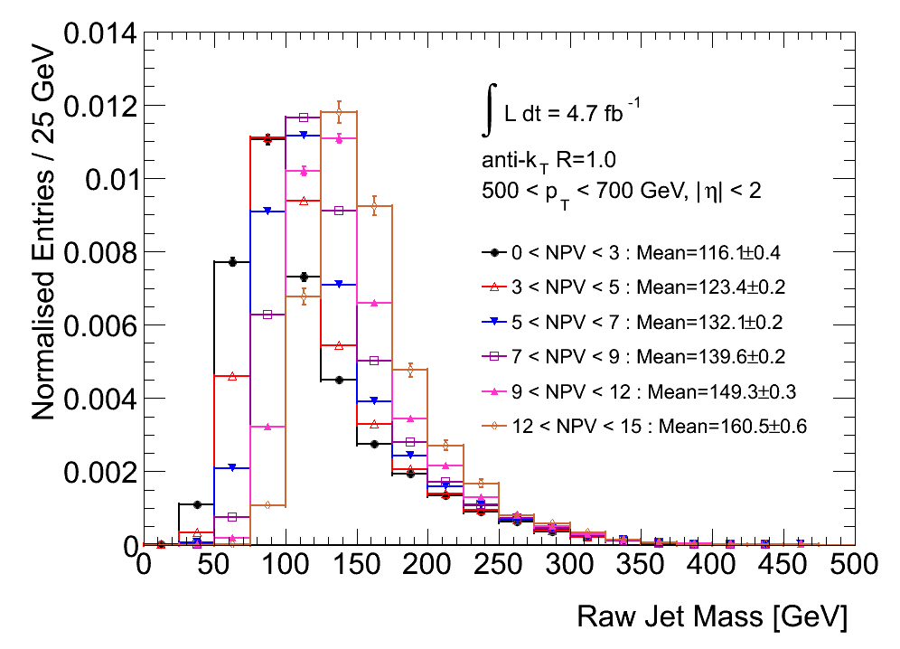
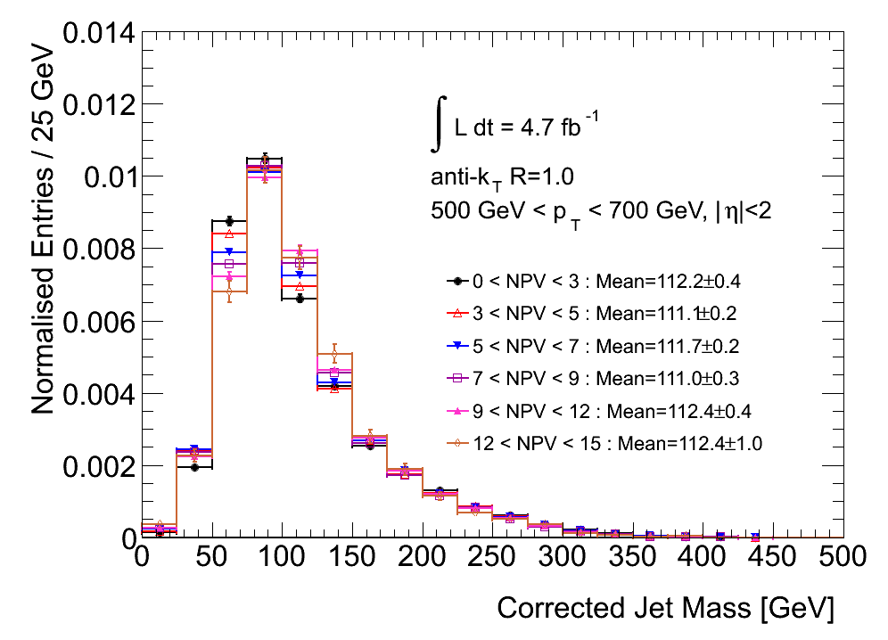
Addressing Pile-Up
Jets are extended objects
Contributions from additional
interactions have significant
effect on observed properties
Various strategies to address
Correct with average calibration
  Only used at Tevatron, and never
  on jet substructure
Correct event-by-event
  Works OK but cumbersome
Can “cut-out” pile-up contributions
  This is method of choice
  Requires careful calibration
Farooque, Ph.D. Thesis

Slide 37
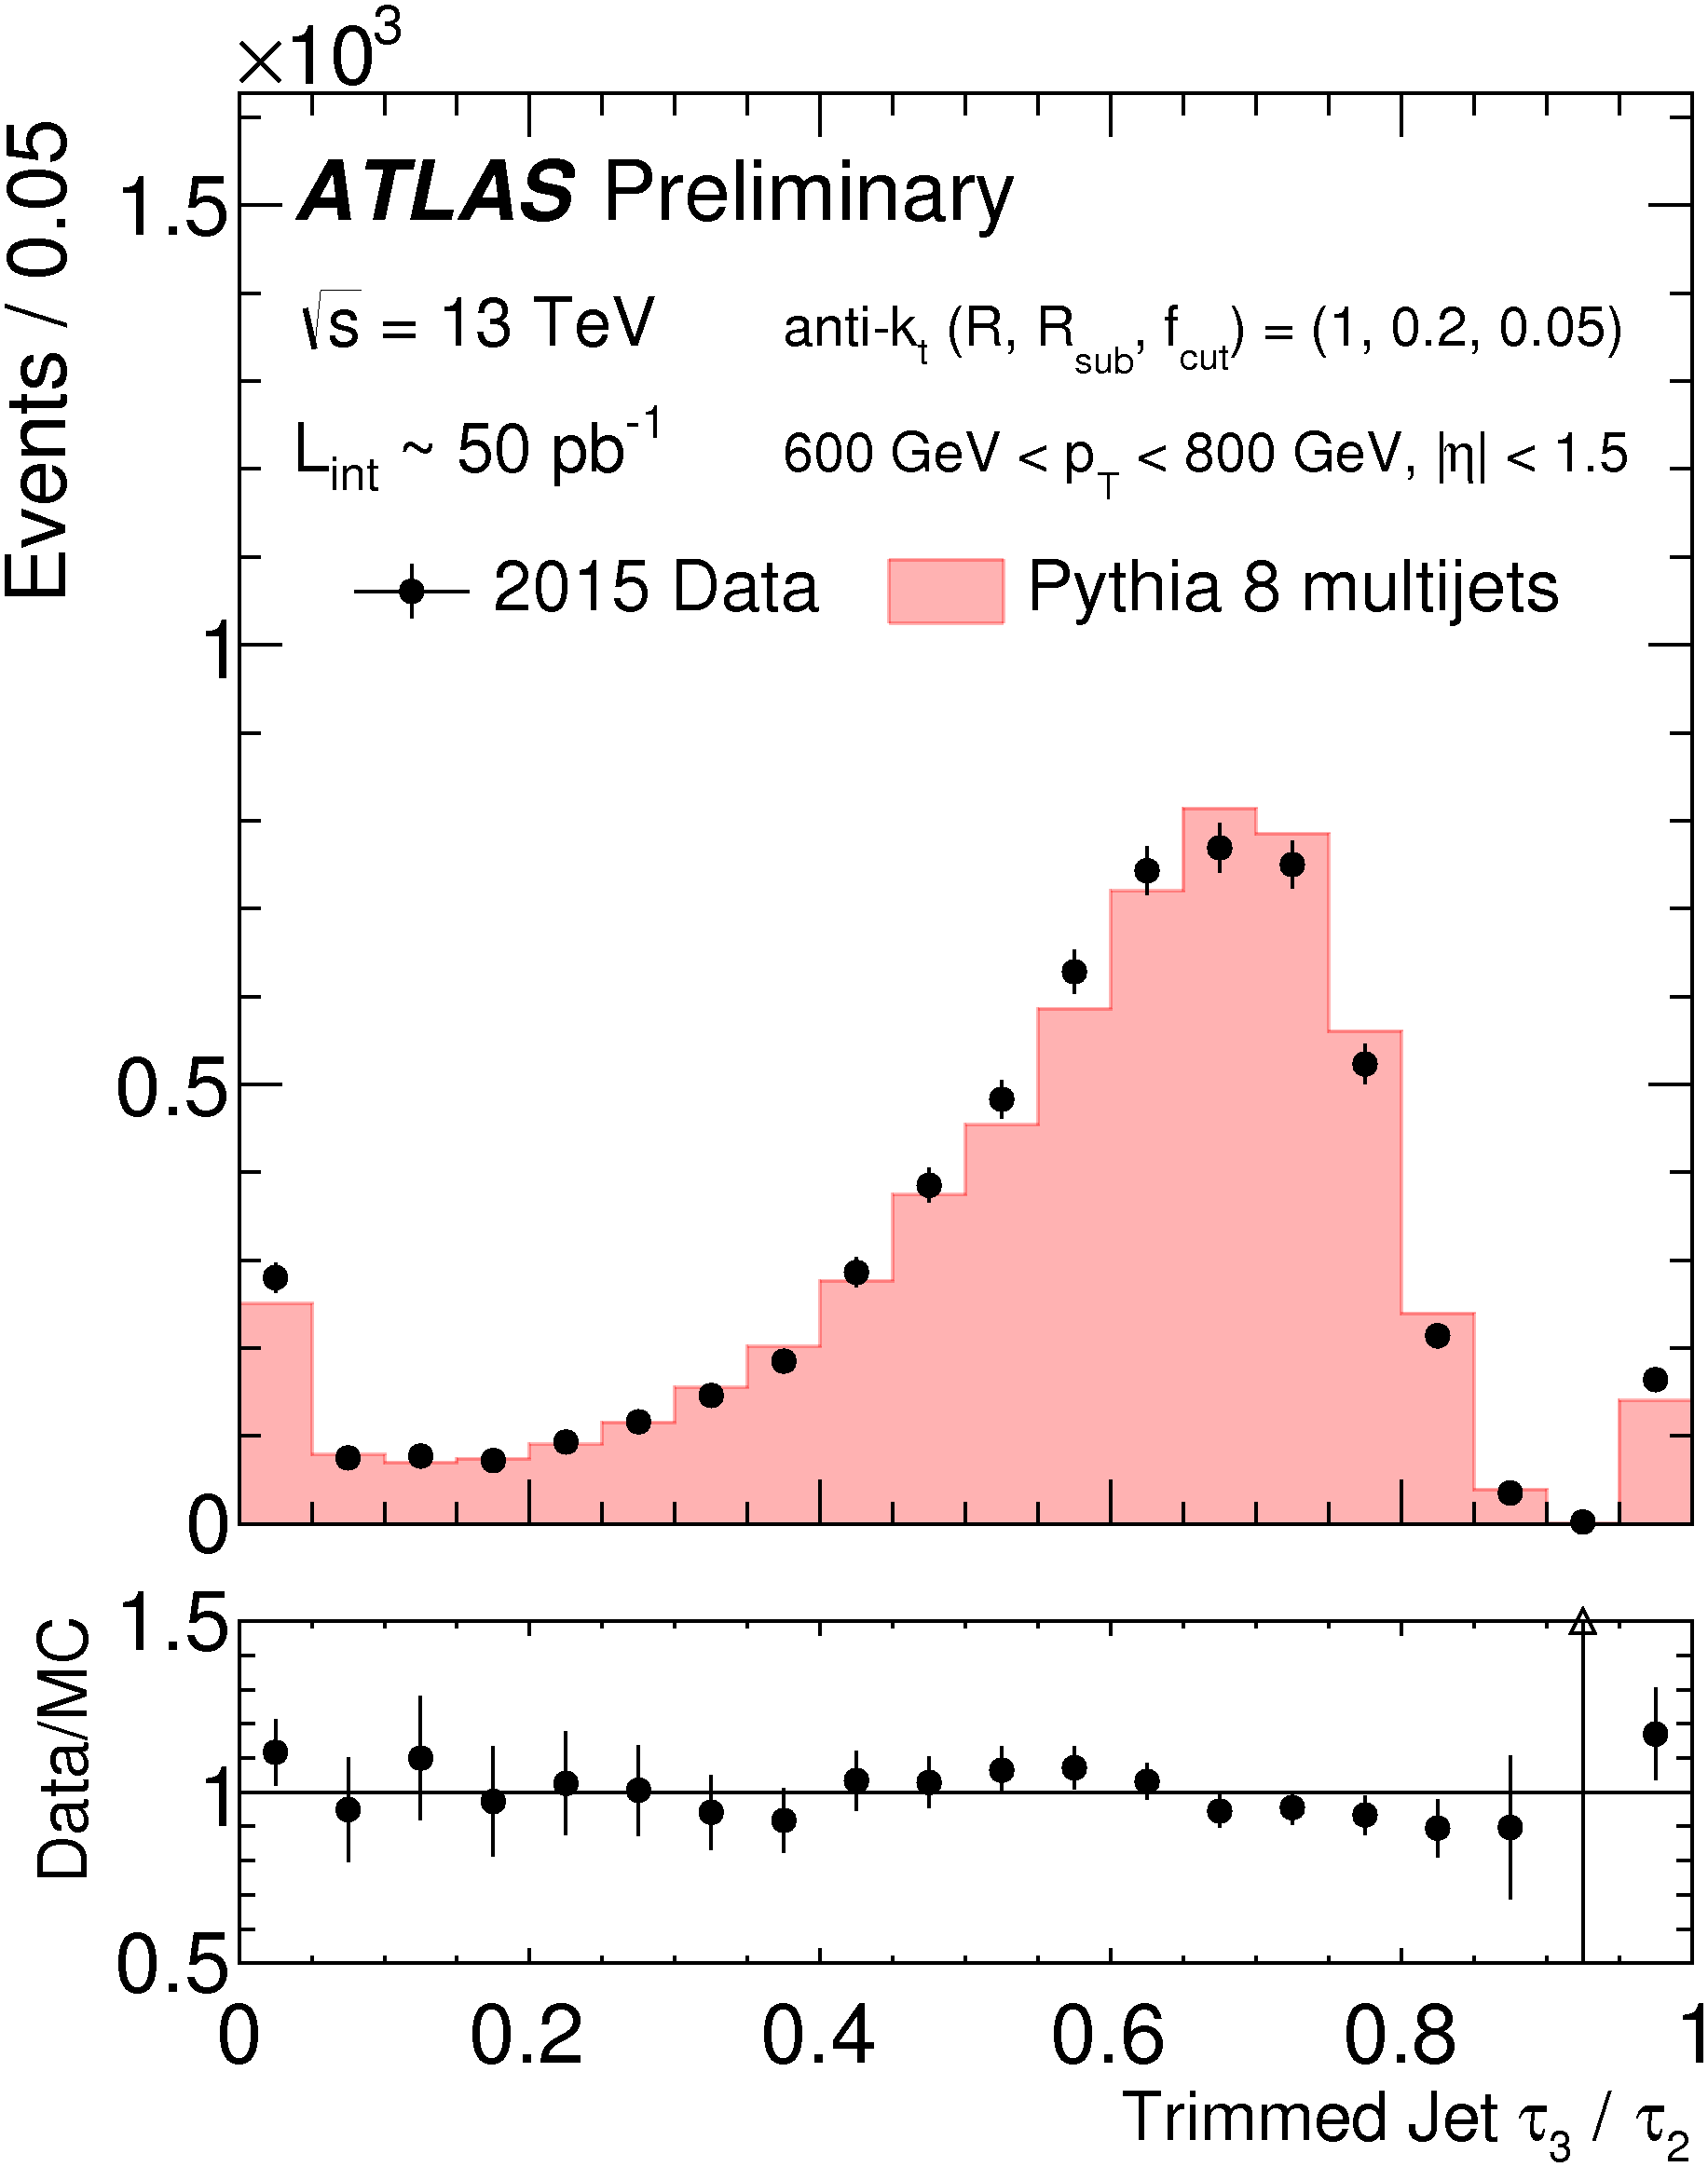
Tau₃₂ Modelling
Thaler & van Tilburg, JHEP 03 (2011) 015; JHEP 02 (2012) 093

Slide 38
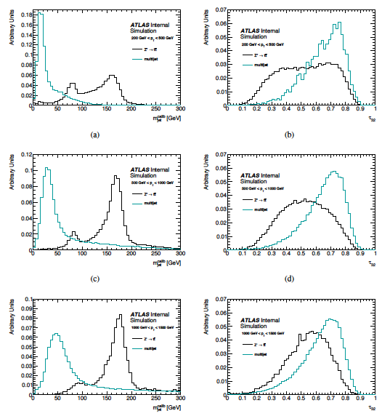
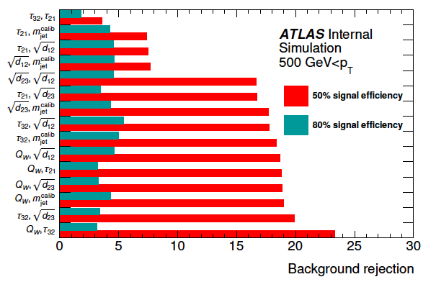
Current Choice of Algorithms
Looked at algorithm with 2 variables:
Optimitized for jets with
p_{T} > 500 GeV,
M_{jet} > 125 GeV
τ₃₂ > 0.58

Slide 39
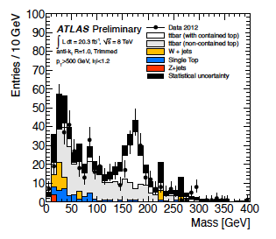
Aside: Trimming Cuts Out QCD Too
Trimming removes part of the QCD jet as well
Current parameters remove 100 GeV subjet for a 1 TeV object!
Requires good fragmentation models in order to calibrate correctly
Competing schemes for this
  Mass-drop
  C/A clustering
Optimizing f_{cut} and R_{sub} remain open questions

