Slide 1


Lake Louise Winter Institute
February 17 – 23, 2013
Review of ATLAS Higgs (like) Boson Results
Robert S. Orr
University of Toronto
on behalf of the
ATLAS Collaboration

Slide 2
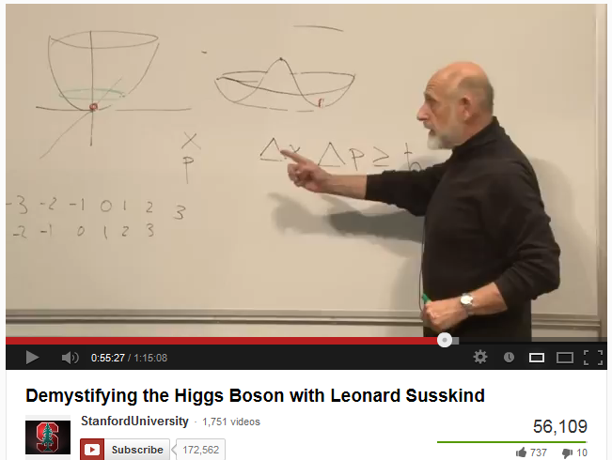
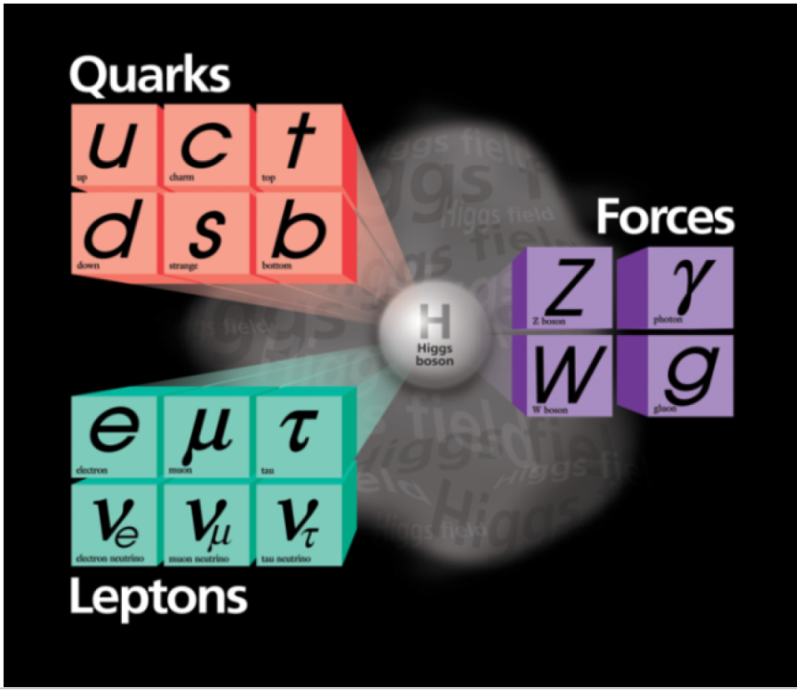
Plan of Talk
Existence of Higgs boson is Central to the Standard Model (see below)
I assume that you know this.
If not (even if you do)

Slide 3
Plan of Talk
“What is now proved, was once only imagined” -William Blake
An extraordinary year for Physics
After decades of preparation, a new heavy boson discovered
Experiment – brief.
Data taking conditions – the machine/experiment performance
A historically cautionary tale
Memoire of discovery
Current results
Combination of all channels
Let me denote new boson by “H”

Slide 4
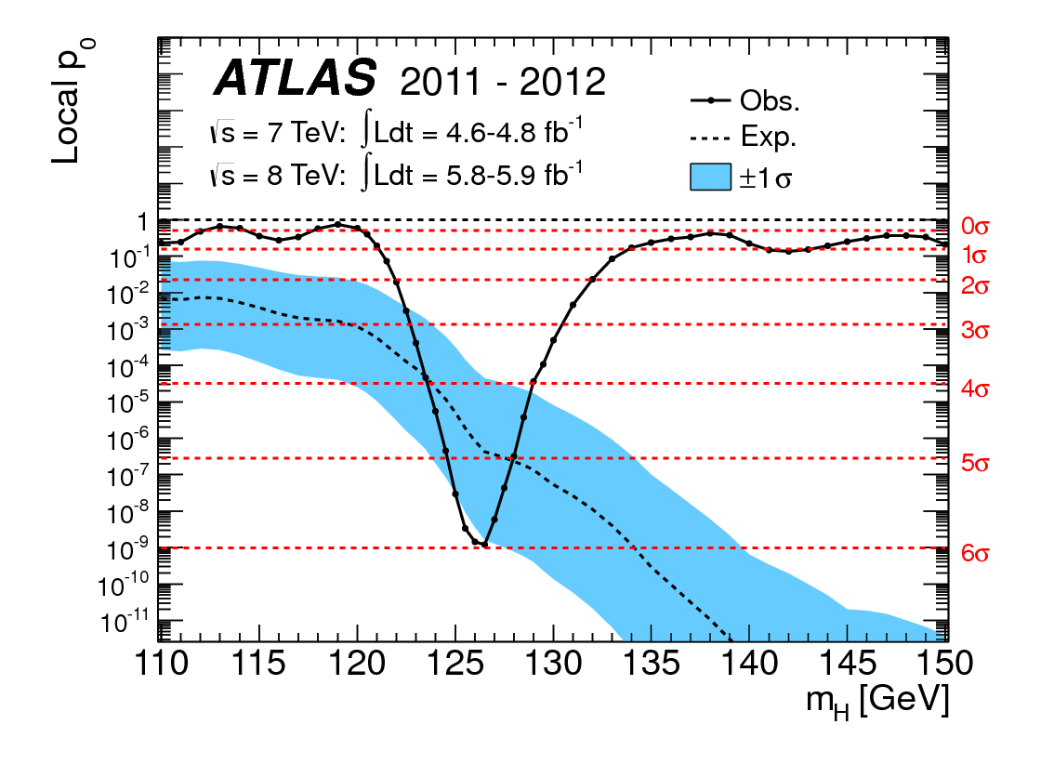
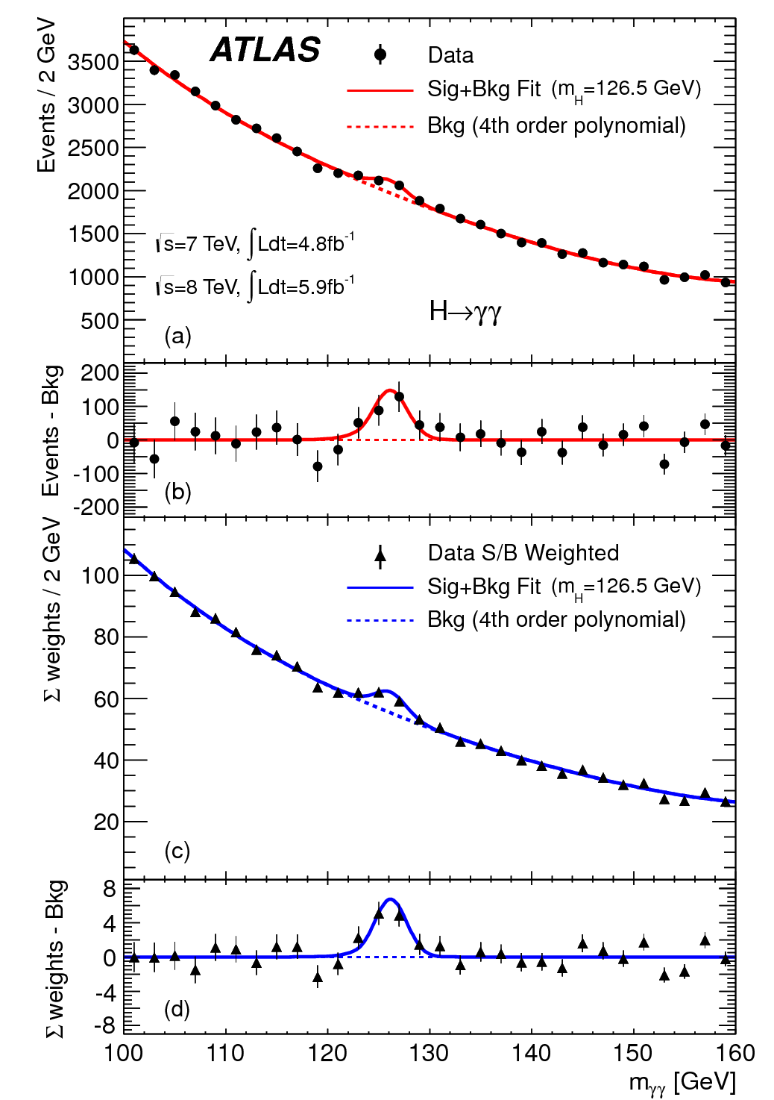
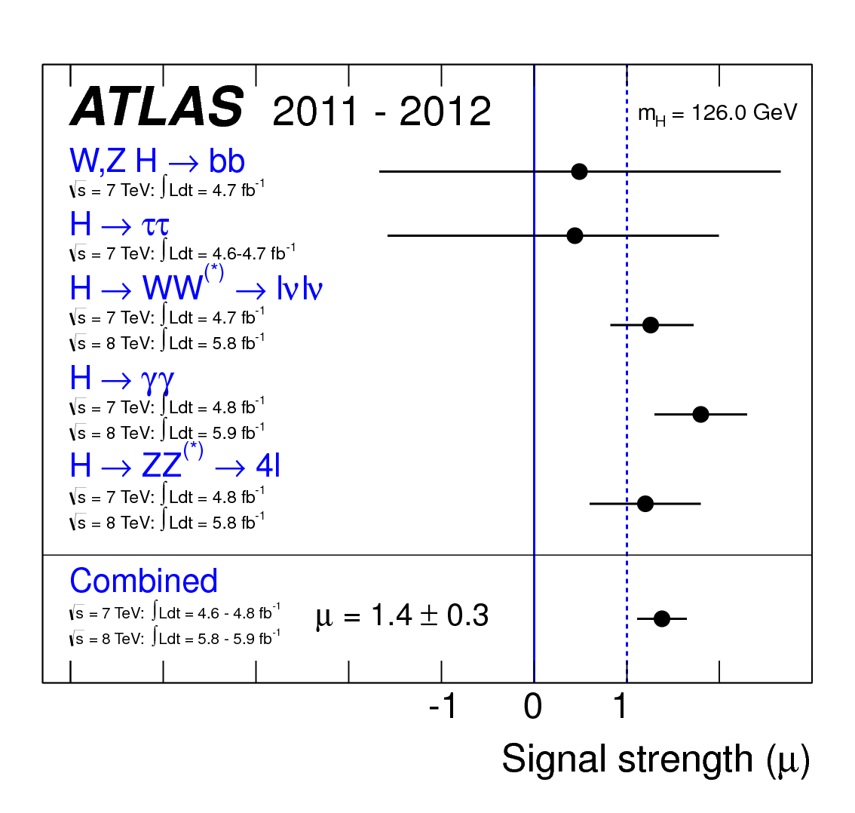
Memoire on Discovery
Phys. Lett. B (2012) 1-29. July 2012

Slide 5
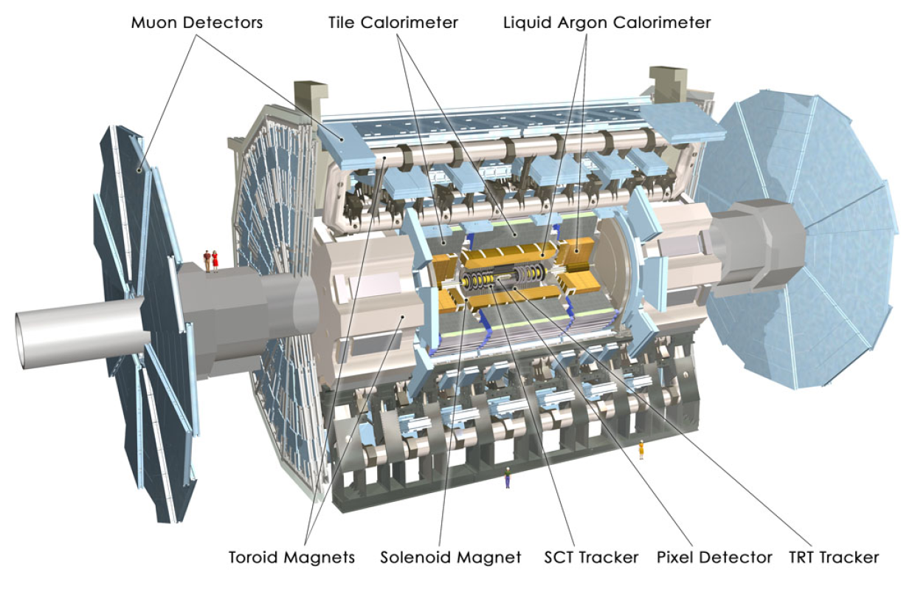
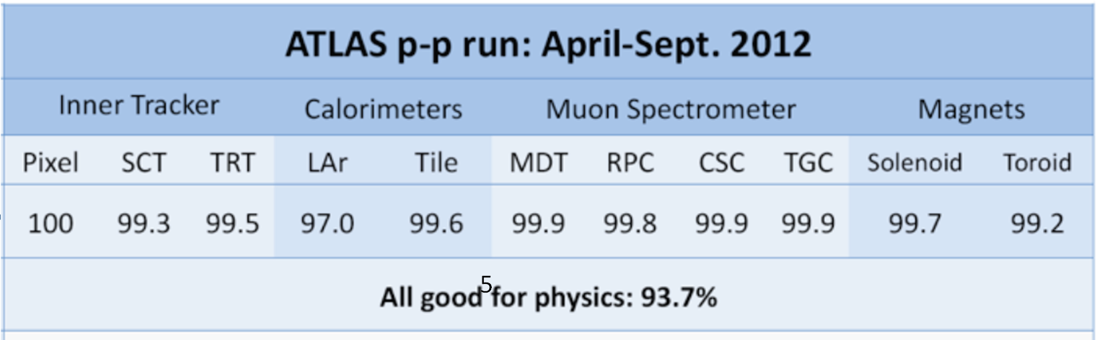

Slide 6
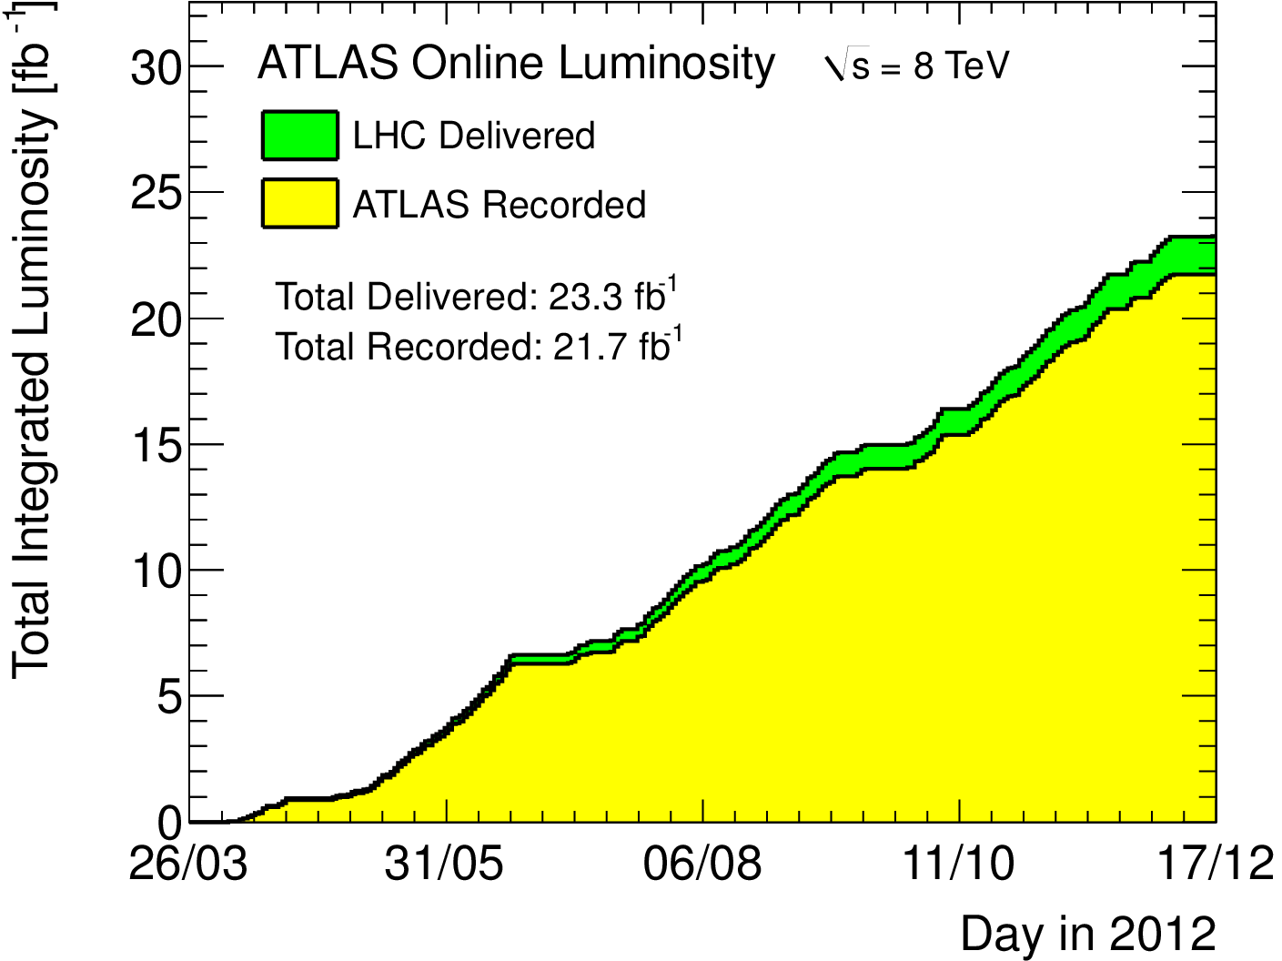
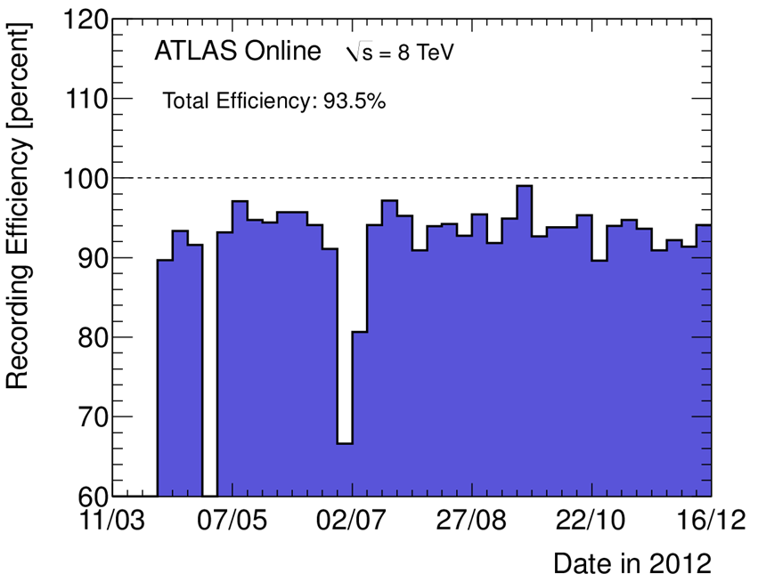
Data Taking
Excellent LHC running
Peak Luminosity
@ 8TeV delivered
ATLAS – efficient use of Luminosity

Slide 7
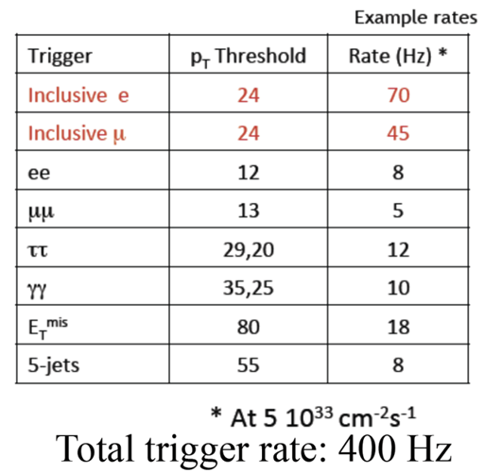
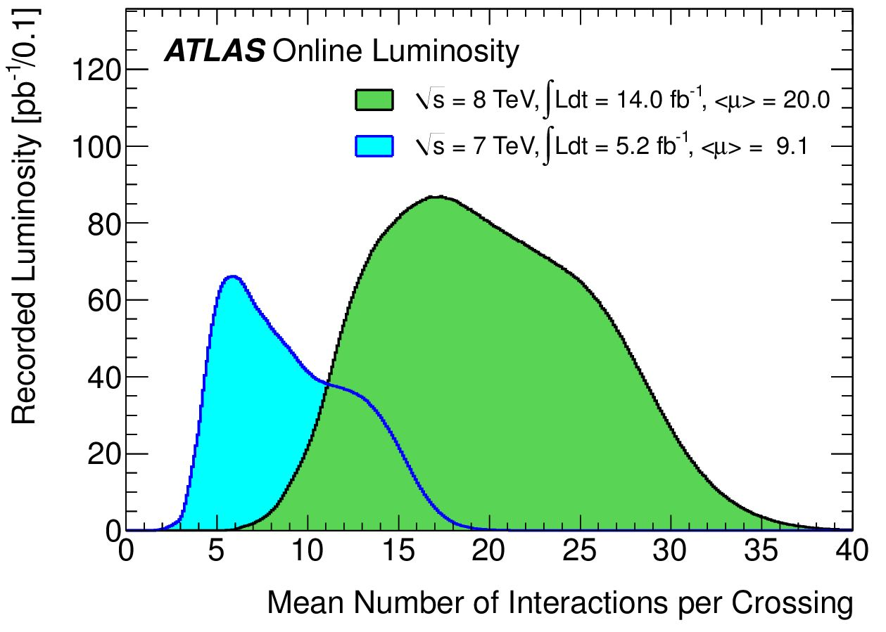
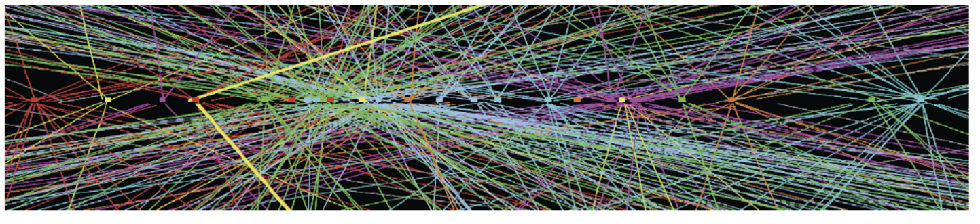
Data Taking
LHC 50 ns crossing – pileup
Requires understanding of how pileup affects
      Trigger
      Reconstruction & Resolutions

Slide 8
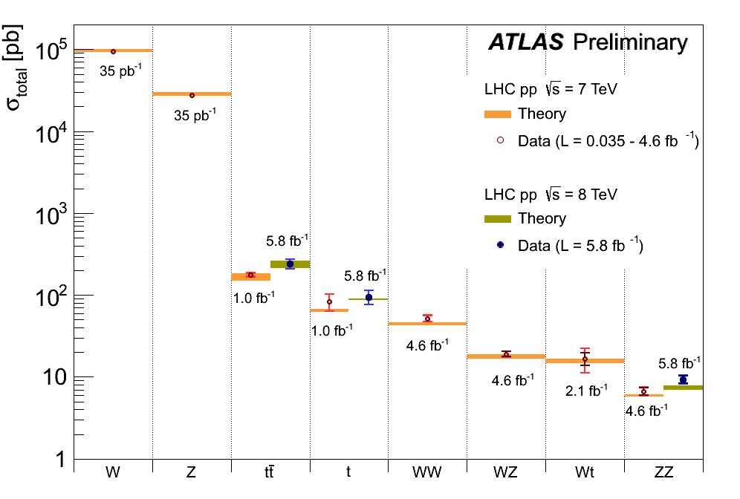
Standard Model Cross Sections
Higgs cross section in observable modes

Slide 9
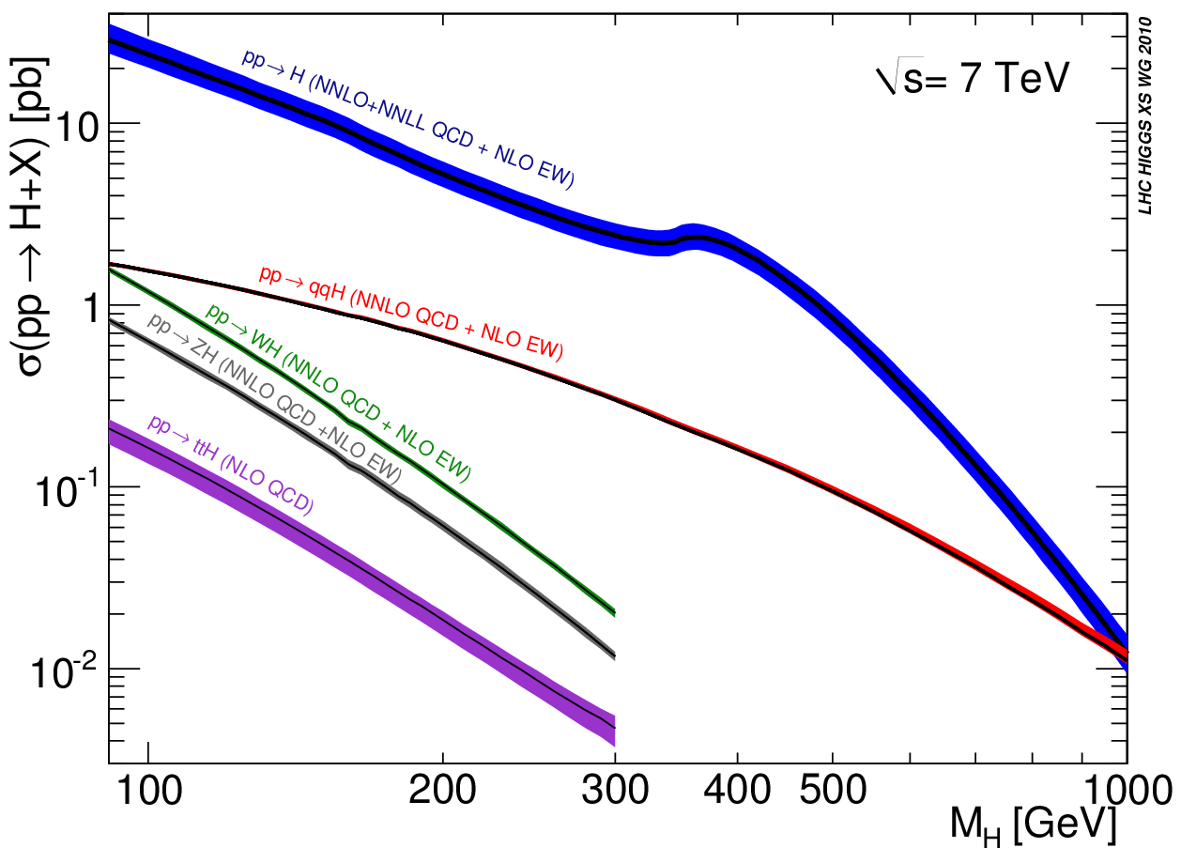
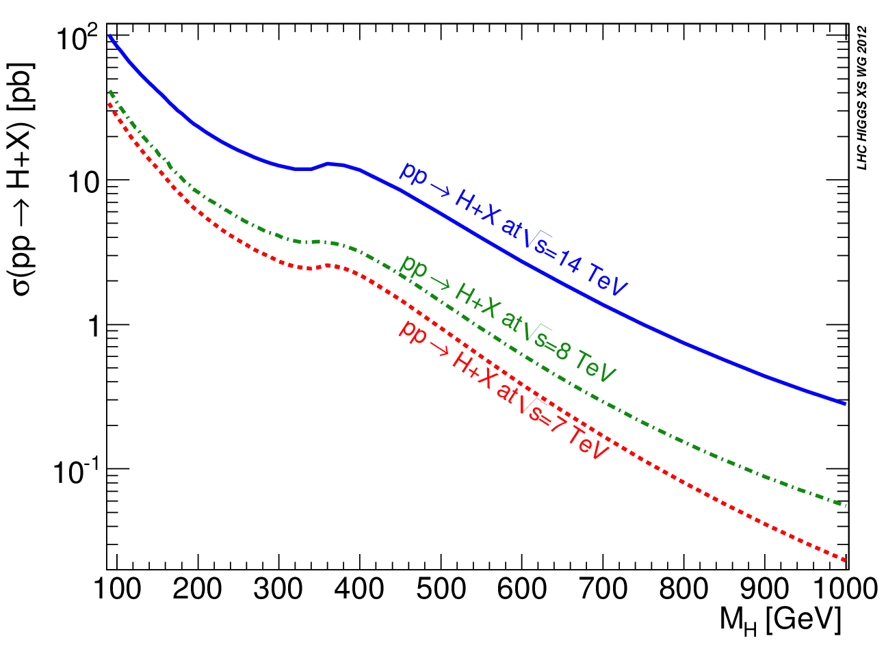
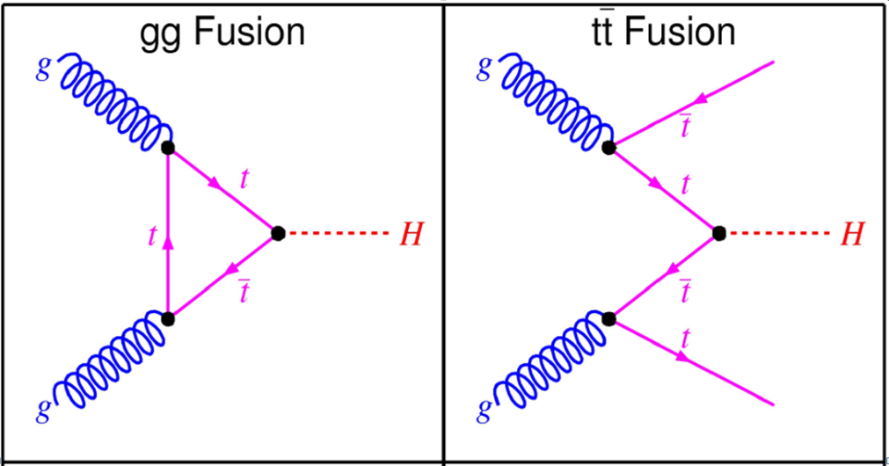
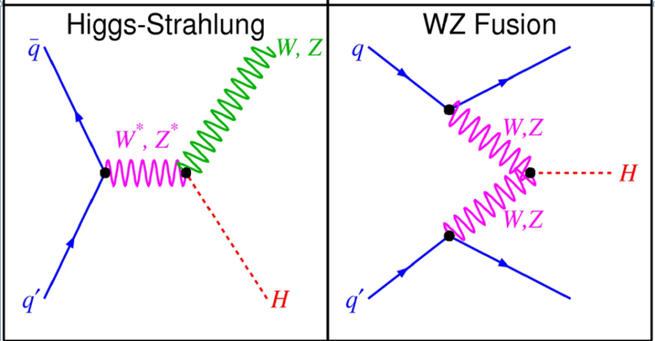
Production Mechanisms

Slide 10
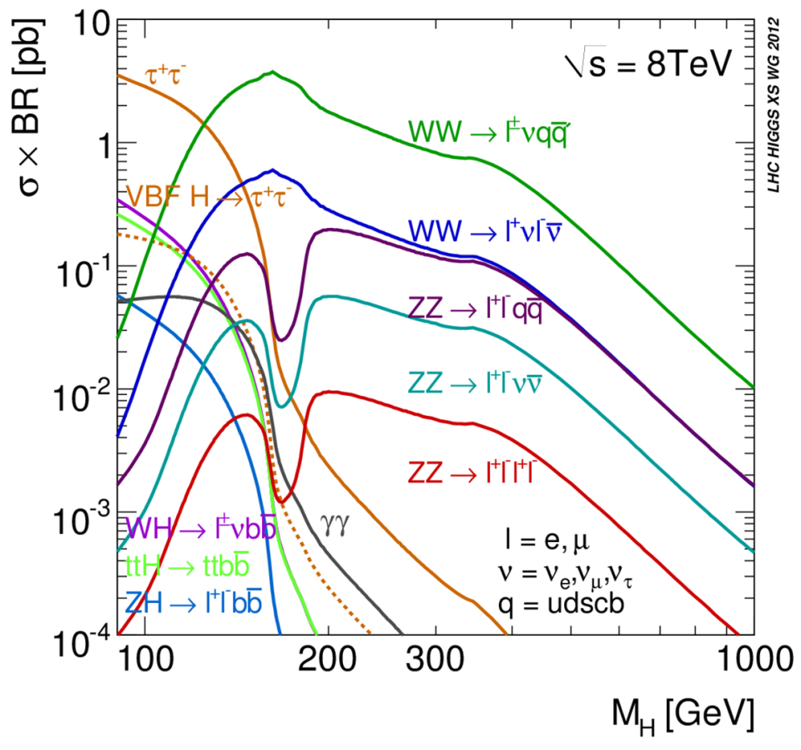
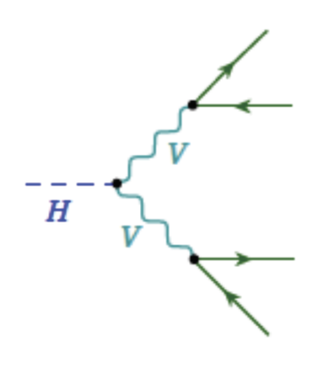
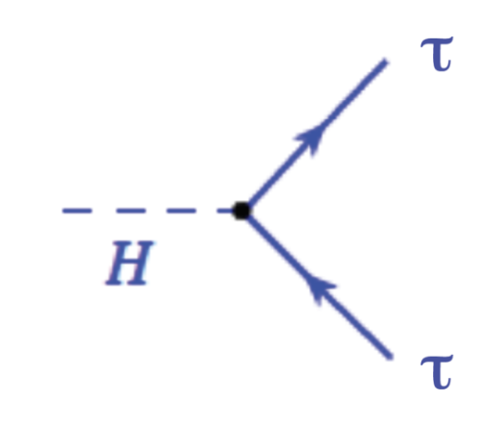
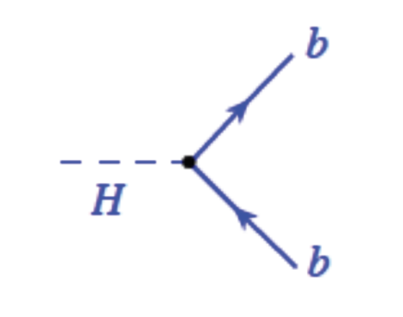
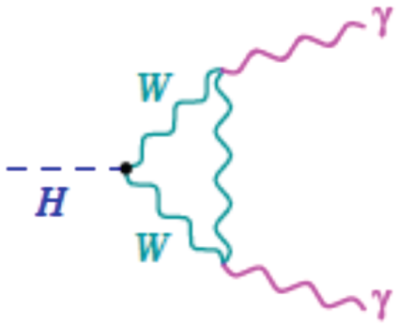
Decay Mechanisms
Bosons
Fermions

Slide 11
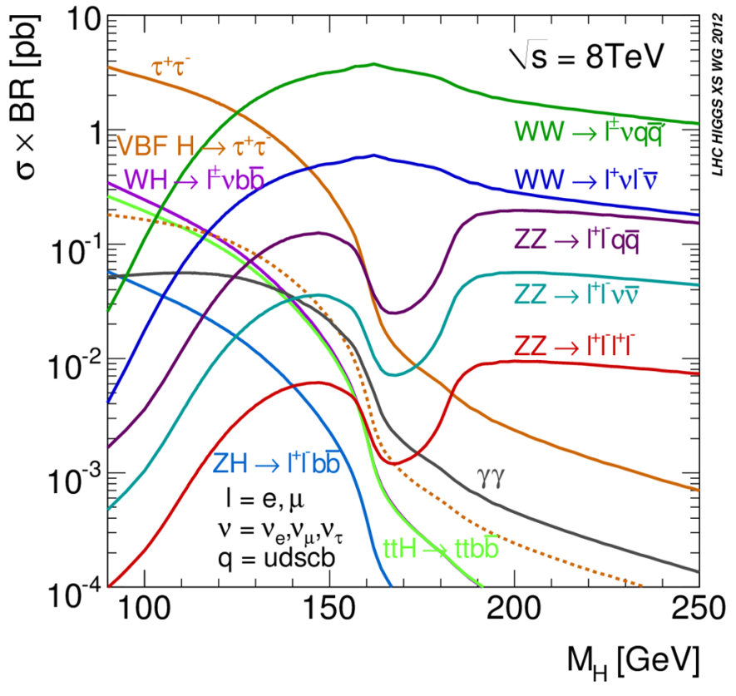
Experimental Advantages of Decay Channels
Good sensitivity above about
100 GeV.
Smaller branching ratio, but low background and excellent mass resolution.
Important in low mass region. High background, but excellent mass resolution and good , distinction.
VBF production and BR gives good signal to background at low masses. Also interesting for non-SM “Higgs”
Higgsstrahlung gives good sensitivity at low masses.

Slide 12
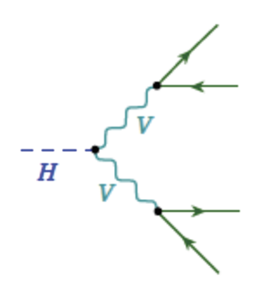
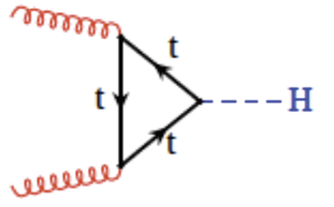
Main production mechanism
Large branching ratio – no mass peak due to νν
  Need good understanding of resolution.
  Sensitive to pileup
Low momentum leptons at low – large backgrounds
Many small backgrounds to understand
      WW, WZ, ZZ, Wγ
      W + jets
      Drell-Yan
      Top
      QCD
Background determination from data essential

Slide 13
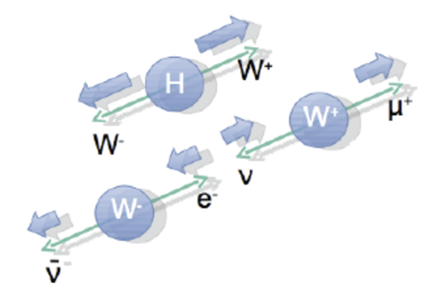
Event pre-selection
  Two opposite charge opposite flavor leptons
  Jets
  Jet vertex fraction >0.5
4 topological categories
  0 jet, 1 jet, leading electron or muon
0 jet
1 jet
  b-jet veto – 85% efficient
  - assume leptons from τ decay

Slide 14
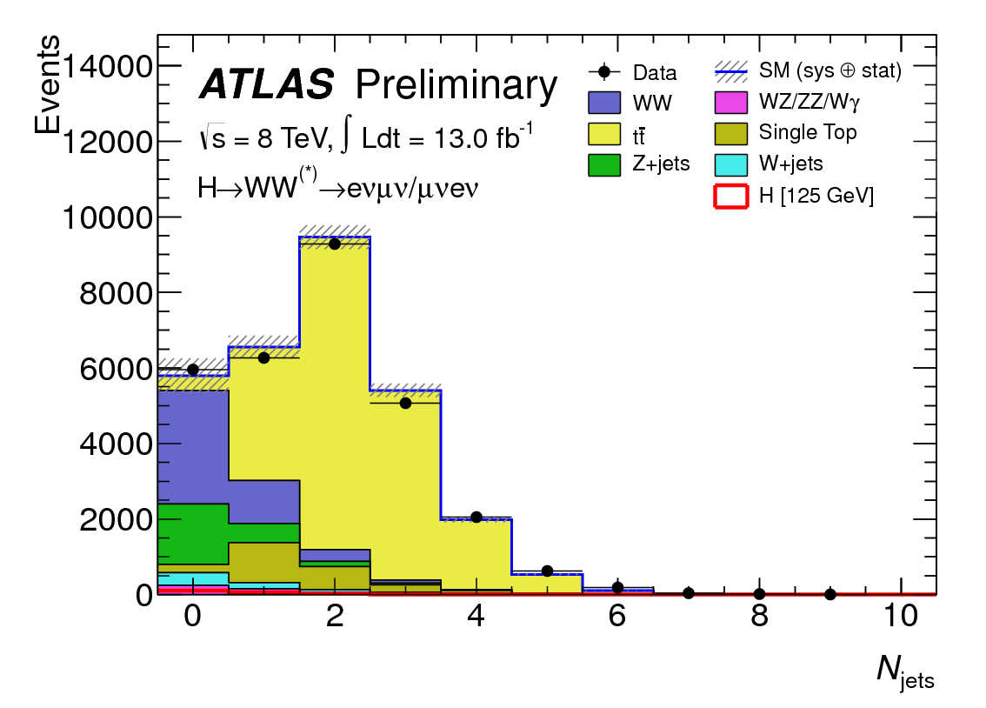
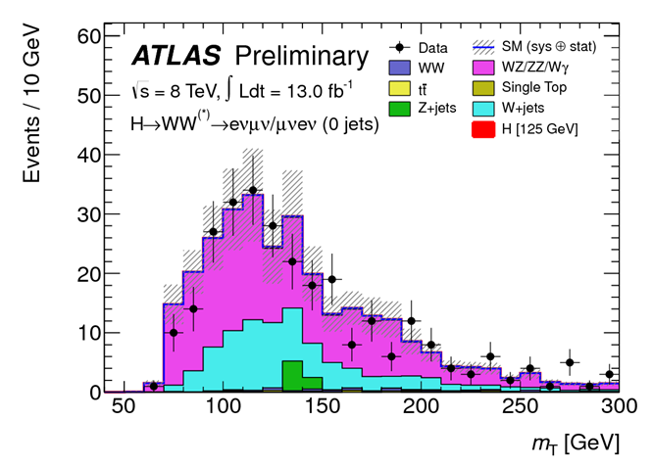
Dominant backgrounds after pre-selection
0 jet – WW, Drell-Yan (suppressed by
W -decay cut)
1 jet – ttbar, single t, WW
2 jet – large top background
      W+jets, WZ/ , ZZ, W
Jet multiplicity after pre-selection
Background estimation –several approaches
  W + jets – data driven approach
  WZ and ZZ – simulation checked with validation regions
  WW and Top use simulation normalized to data in control regions
Same sign lepton, 0 jet validation

Slide 15
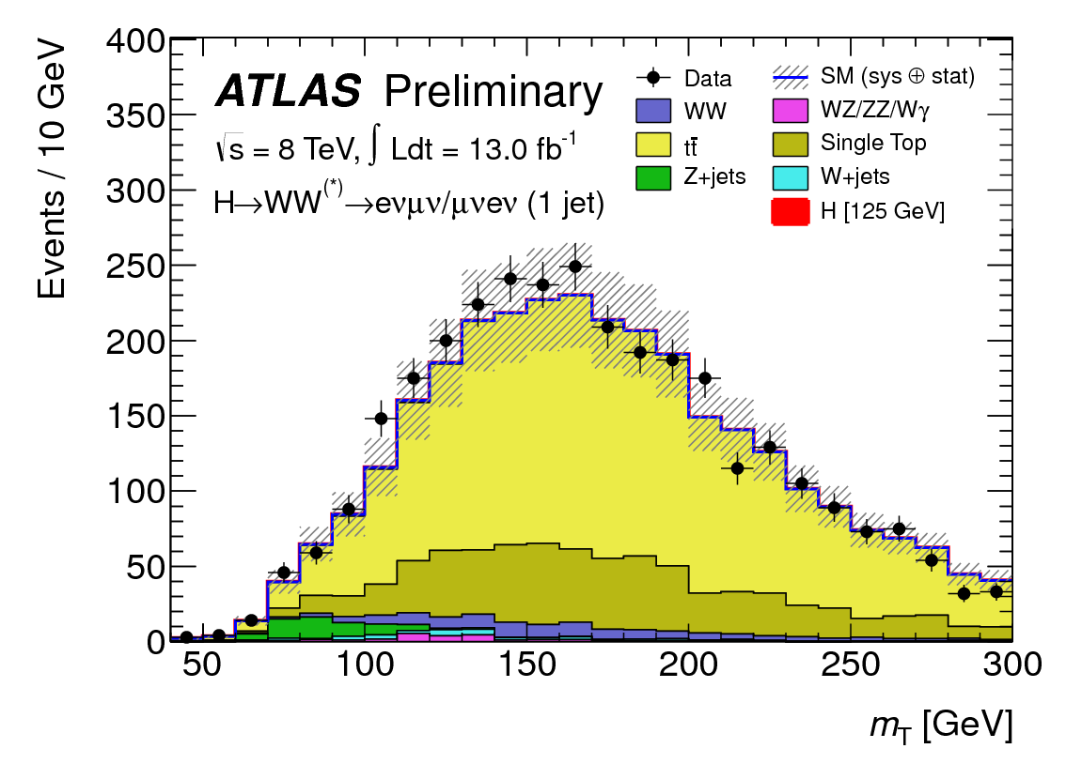
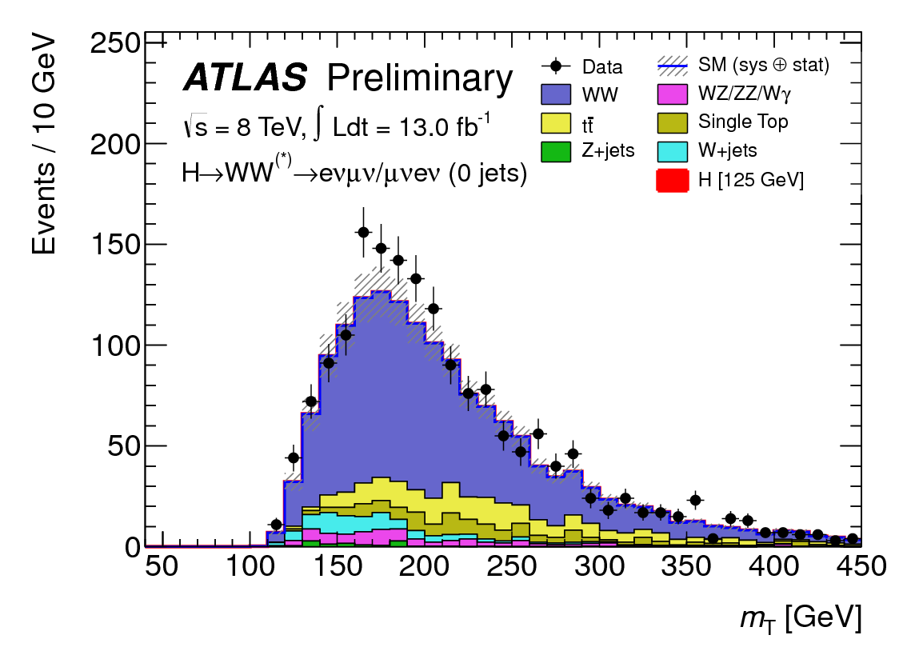
Top: 1-jet control region
  Reverse b-tag veto
  Remove
  Remove
  Uncertainty on ttbar in signal region – 37%
ttbar control region
WW: 0-jet control region
  Remove
  MC / data shapes agree OK
  Uncertainty 0-jet – 13%
  1-jet – 54%
WW control region

Slide 16
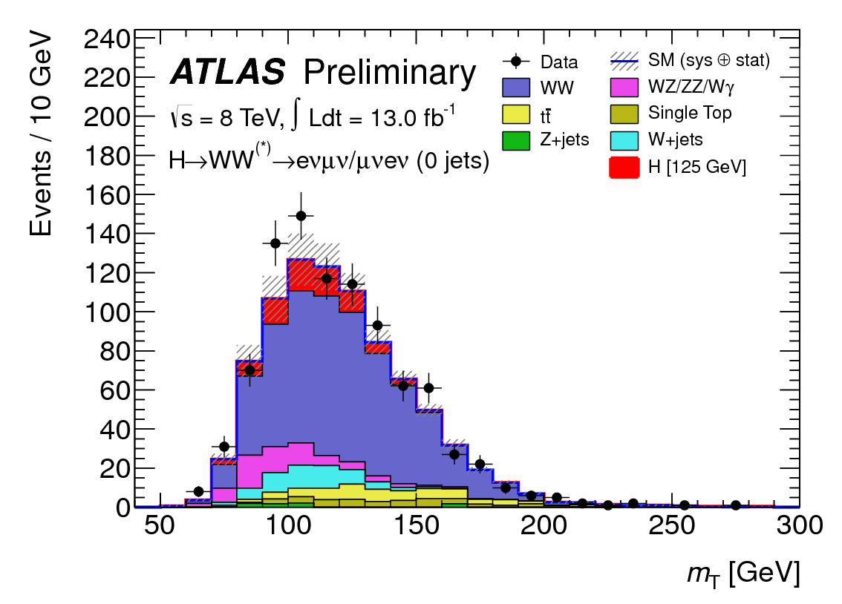
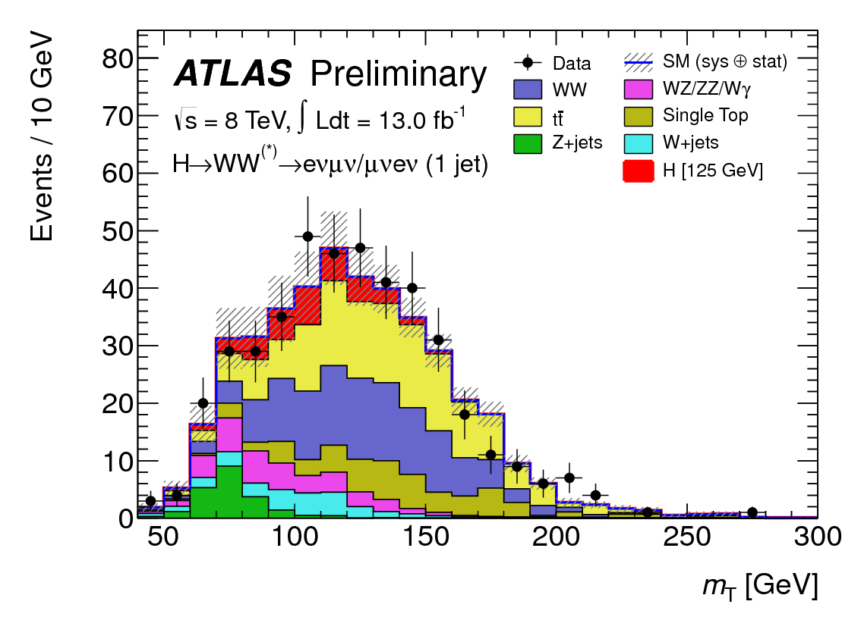
0 jets
1 jet
Typical transverse mass distributions after all selection
eμ and μe combined
Transverse mass distributions - binned likelihood

Slide 17
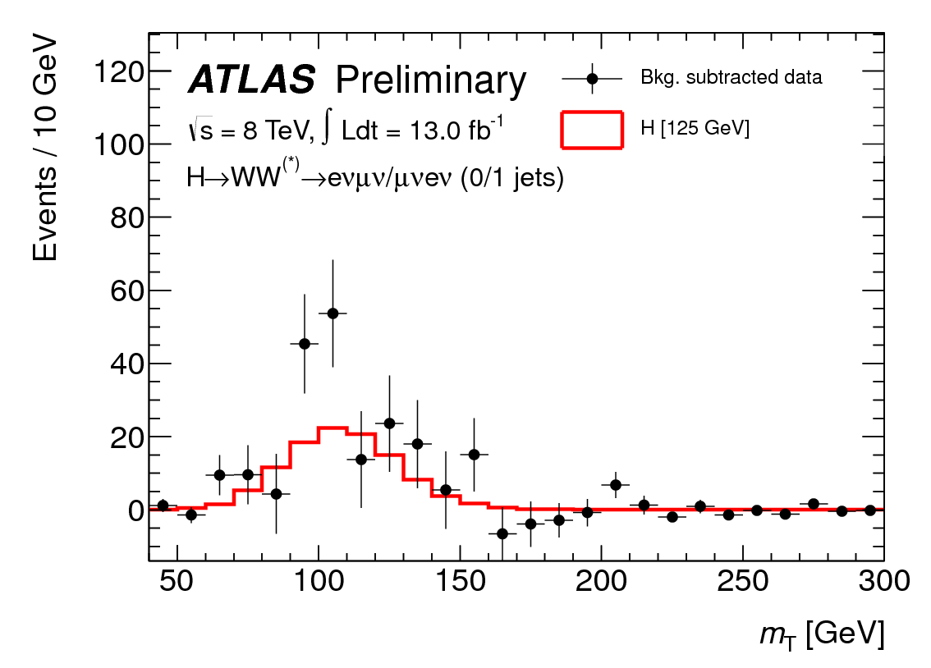
Transverse mass distributions after background subtraction
Errors reflect data and background
Background systematics not included

Slide 18
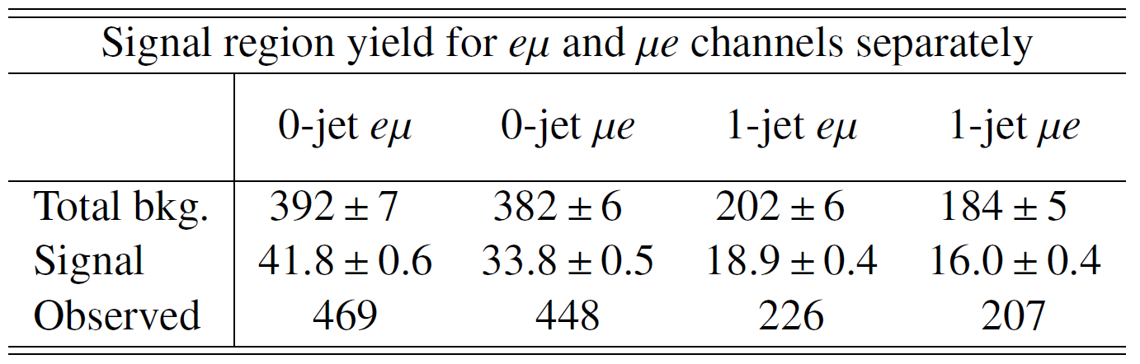
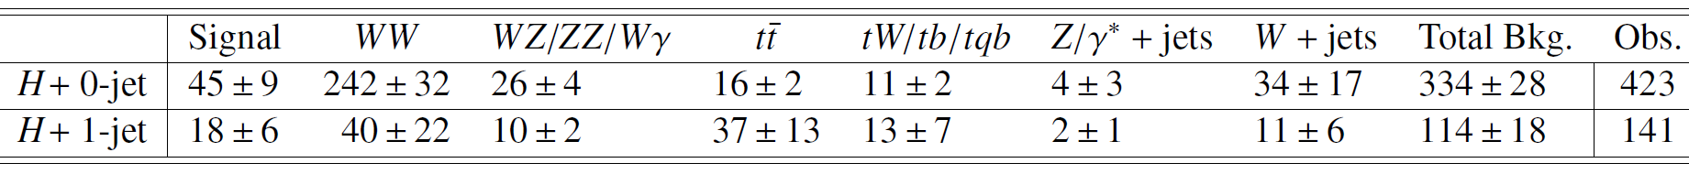
Observed number of events in 4 classes after cut
Internal consistence in 0,1 jet
Observed v. expected events after all cuts, including
Uncertainty on Total Bkg. Includes correlations

Slide 19
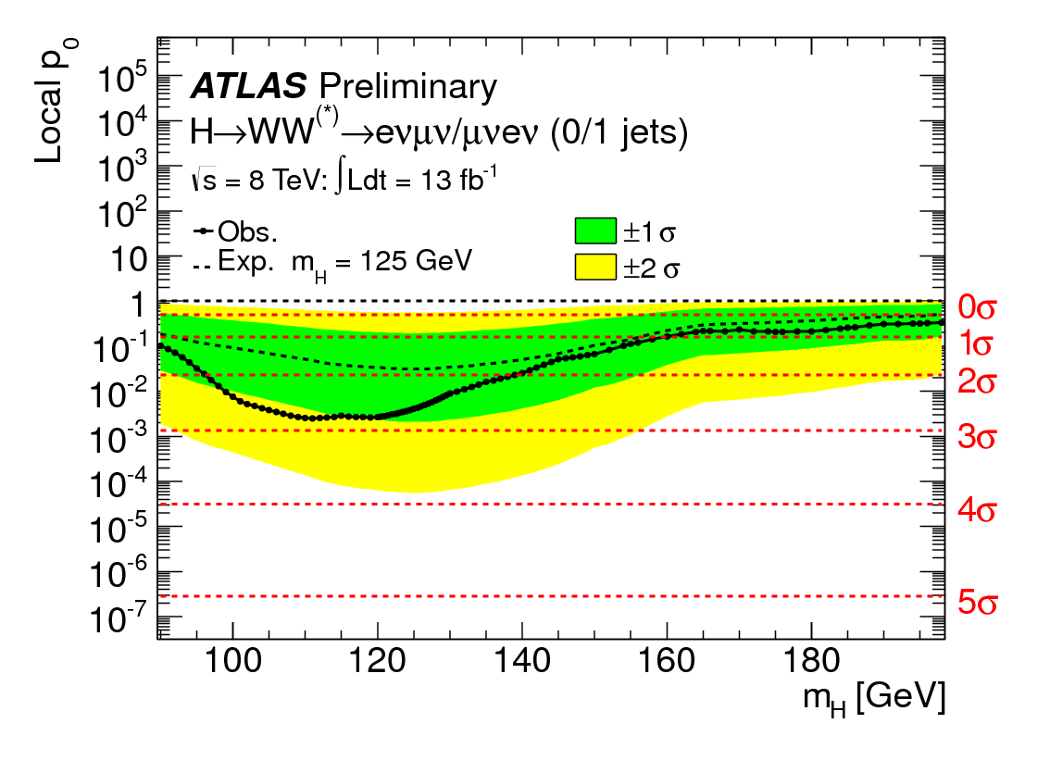
Observed – 2.6σ
Expected – 1.9σ
Signal strength
Standard Model calculation

Slide 20


at 7 TeV and at 8 TeV
Small Branching Fraction to 4 charged leptons
  Premium on luminosity
Completely reconstruct Higgs mass
  Very good mass resolution ~1.2 – 2%
  Very low backgrounds
  Need very good lepton reconstruction
  and identification even in pileup conditions
Clear signal of Higgs coupling to weak bosons

Slide 21
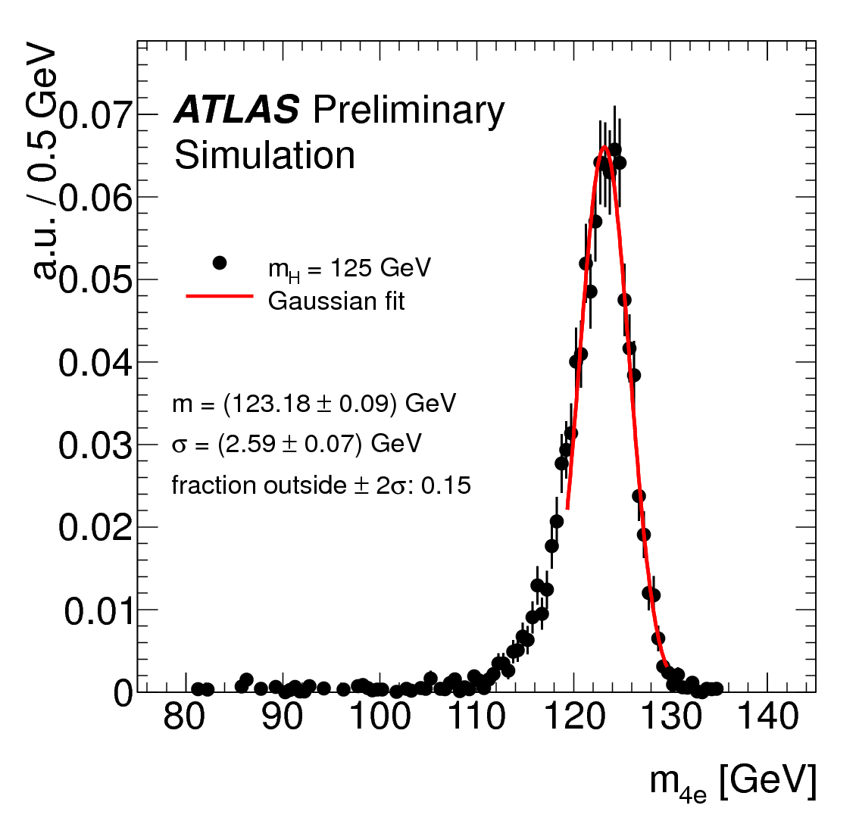
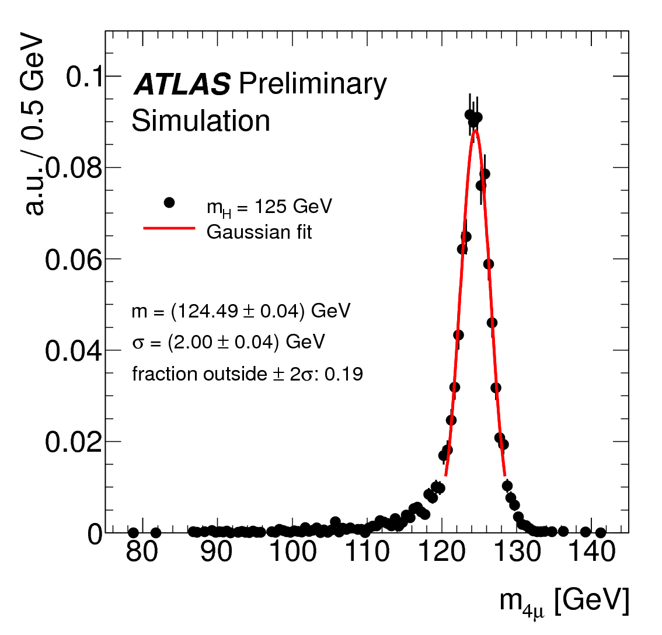
Clean signal
  4-lepton mass resolution enhances signal
Reducible backgrounds Z+bb, Z+jets, ttbar
  reduced by lepton isolation, impact parameter and dilepton mass
  control regions built with cross checks;
    Invert isolation
    d0
    Loosen ID criteria
    Same-sign sub-leading leptons (Z + jets)
Irreducible backgrounds - simulation
normalized to theory cross section

Slide 22
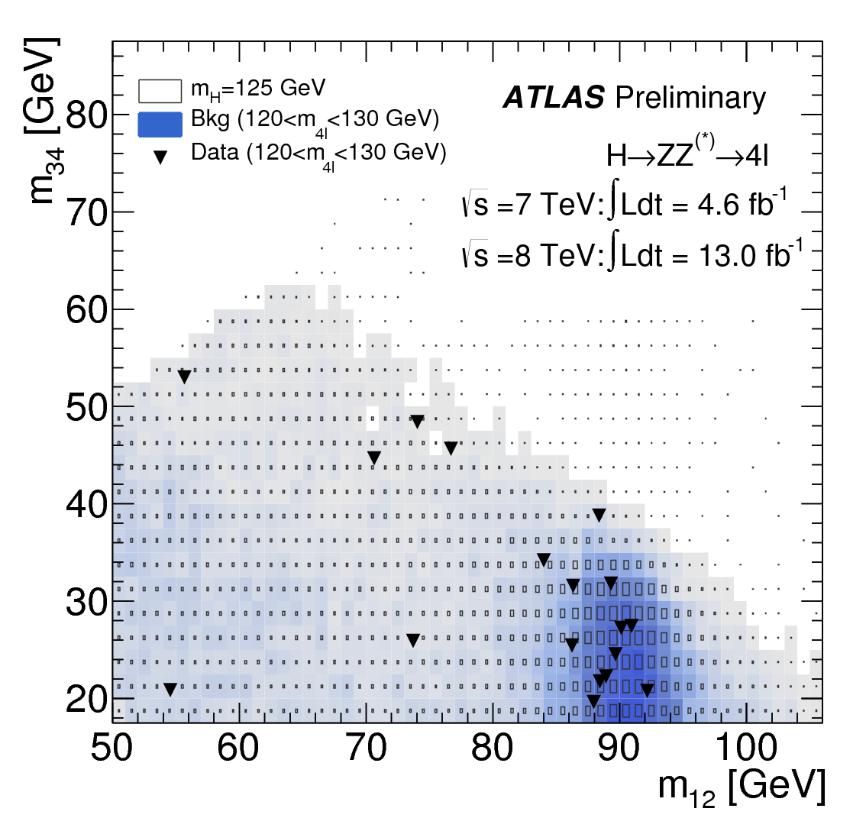
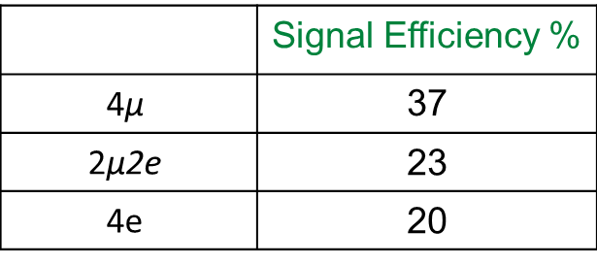
Event selection:
  4 leptons
  Pair same flavor opp. charge leptons, mass closest to Z is
  - minimum chosen for is 17.5 GeV for a Higgs mass of 125 GeV
  Same flavor combination
 | Signal Efficiency %
$$\text{4}\text{μ}$$ | 37
$$\text{2}\text{μ}\text{2}\text{e}$$ | 23
$$\text{4}\text{e}$$ | 20
m₁₂ - m₃₄ of candidates
boxes – signal density
shading – background density

Slide 23
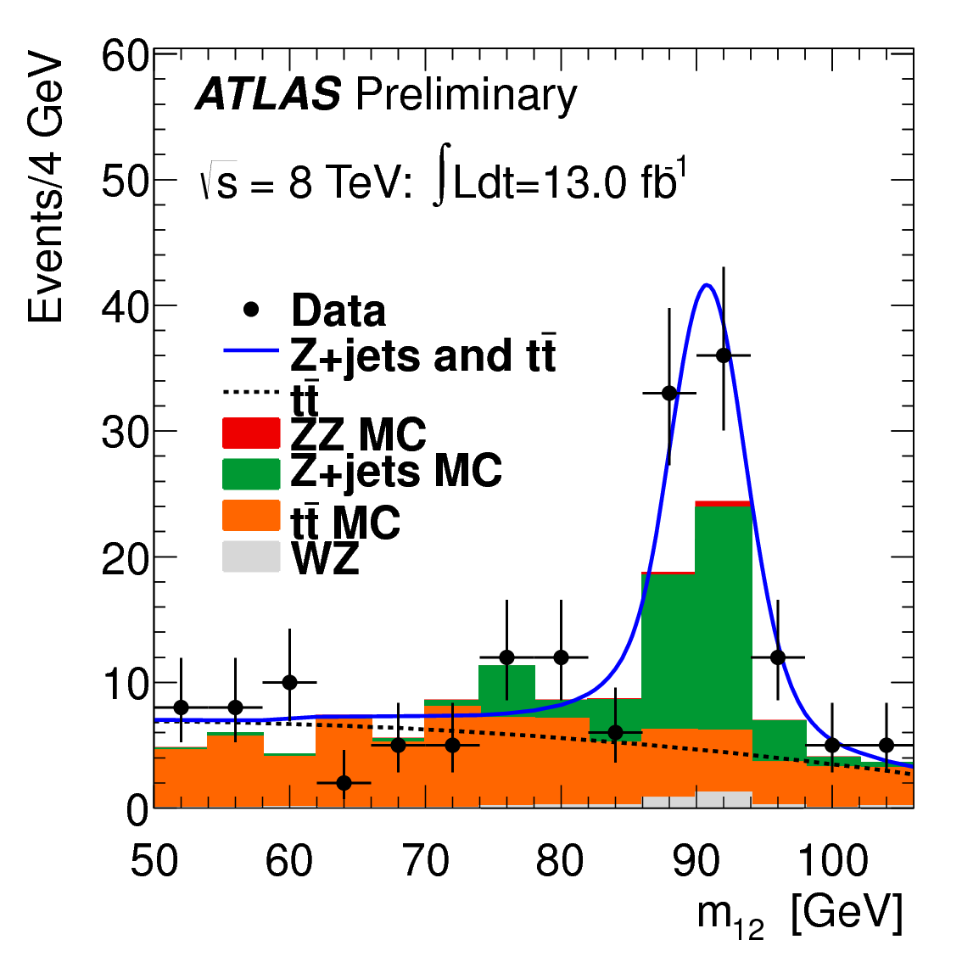
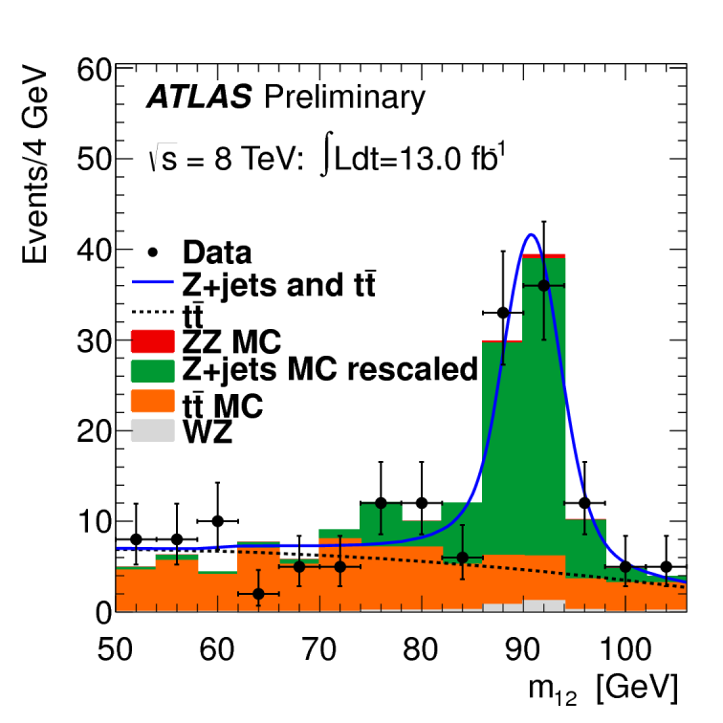
Z +jets and ttbar from data driven methods using control regions:
  bg leptons from bbar.
  relaxed isolation.
Also checked with same-sign dilepton pairs.
Control region:
  increase bbar, by isolation not applied to subleading dimuon.
  one track fails impact param significance, this removes ZZ^{(*)}.
  blue fit used to obtain Z+jets and ttbar.
  cf. simulation.
Control region:
  simulation scaled by data fit.

Slide 24
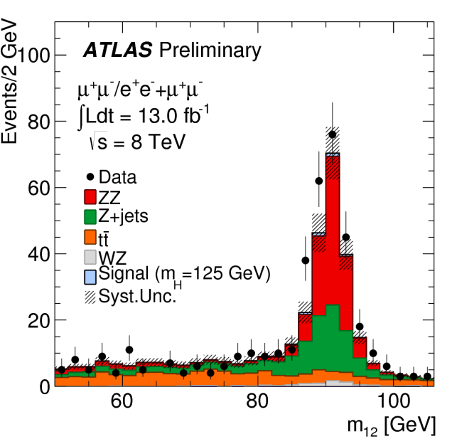
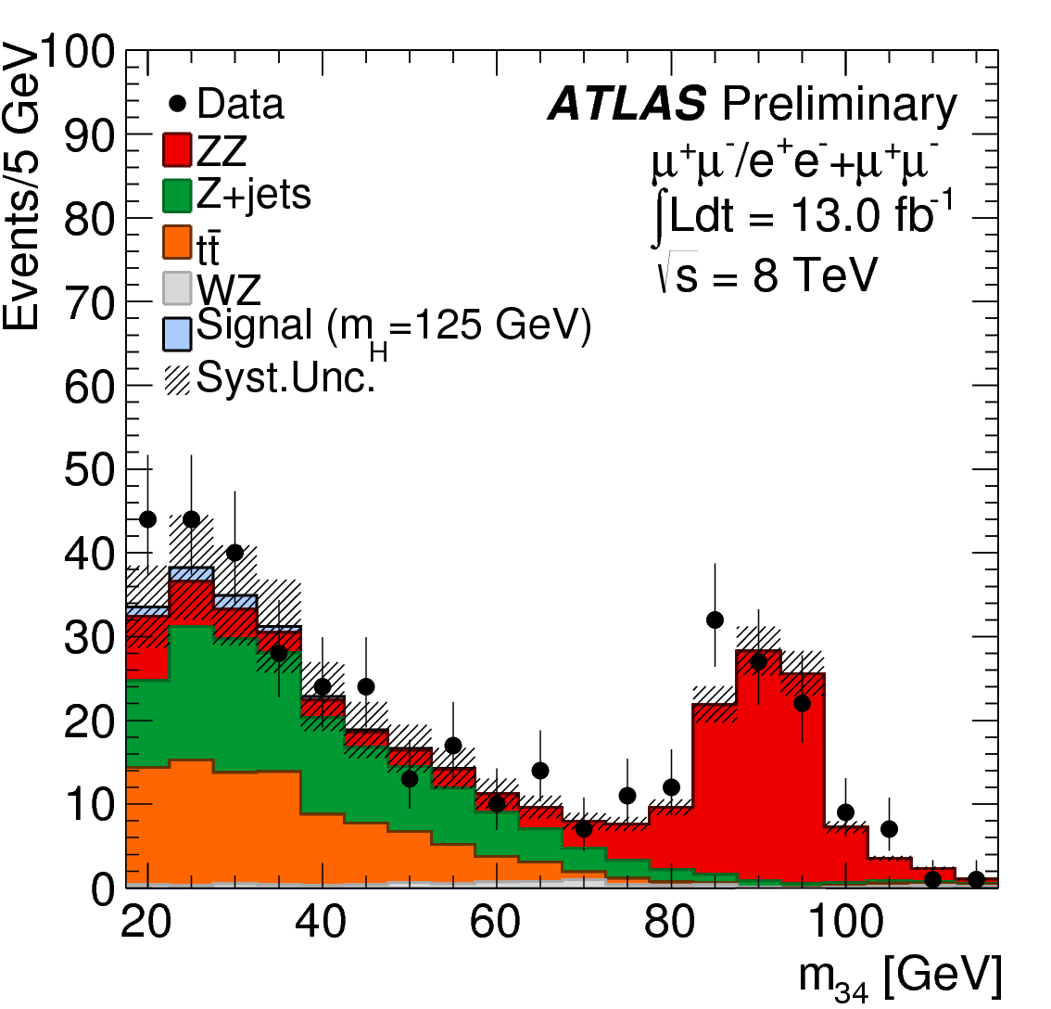
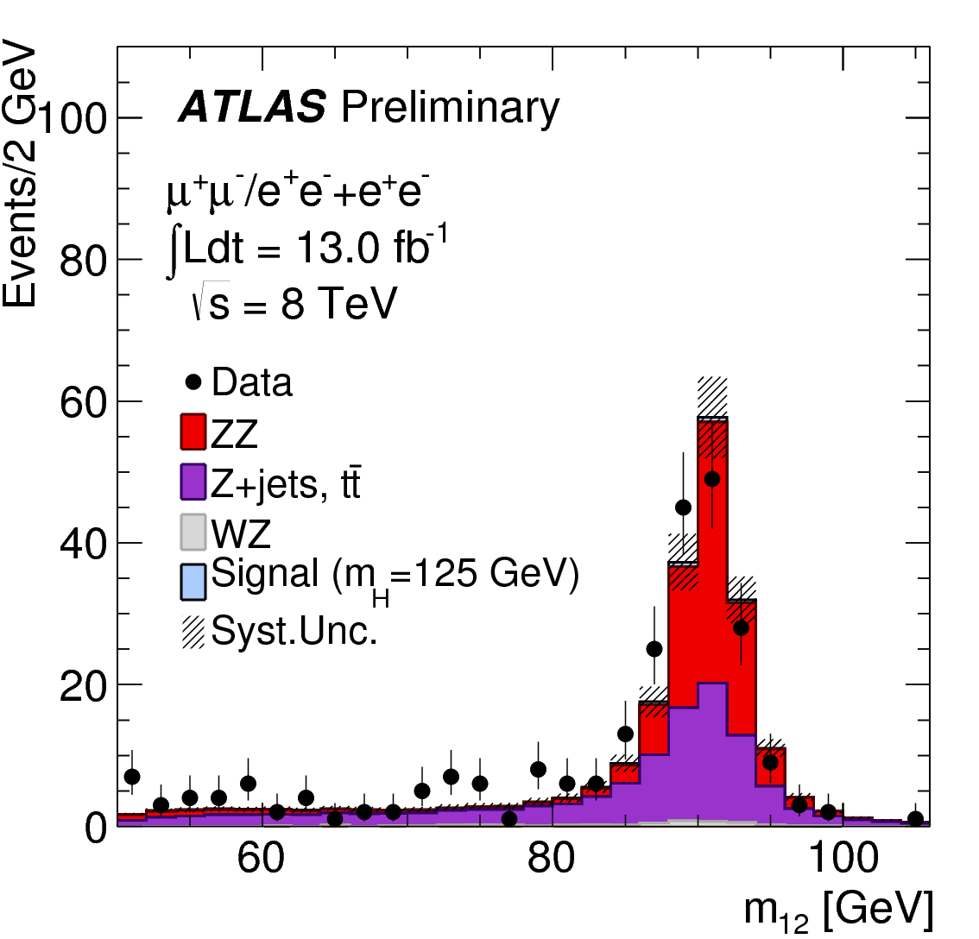
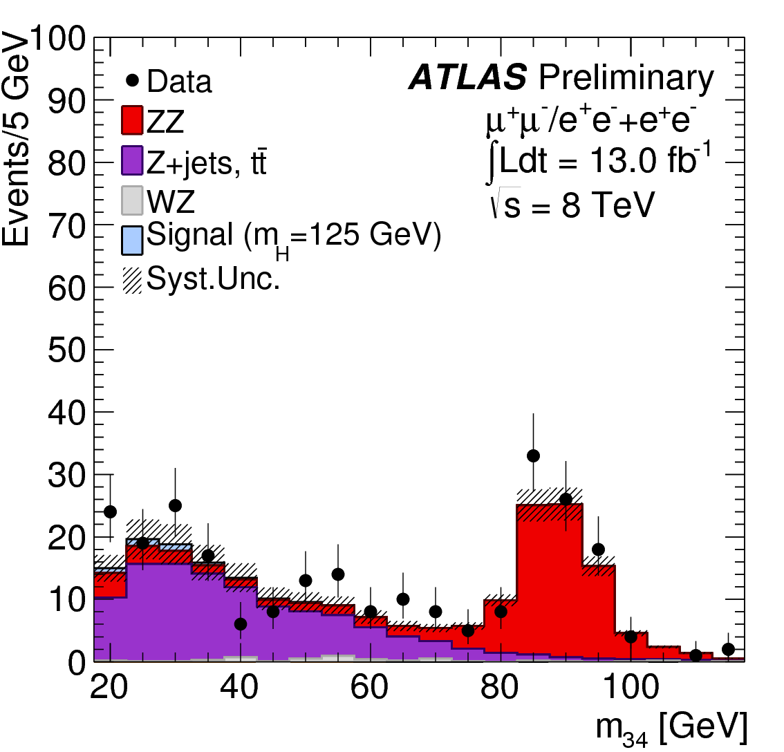
Lepton pairs in control regions:
  Z + additional di-lepton.
  analysis kinematics.
  leading dilepton only:
    Isolation.
    impact param.
sub-leading di-μ
Good agreement:
  shape & normalization.
  high , dominates
  also low
sub-leading di-e

Slide 25
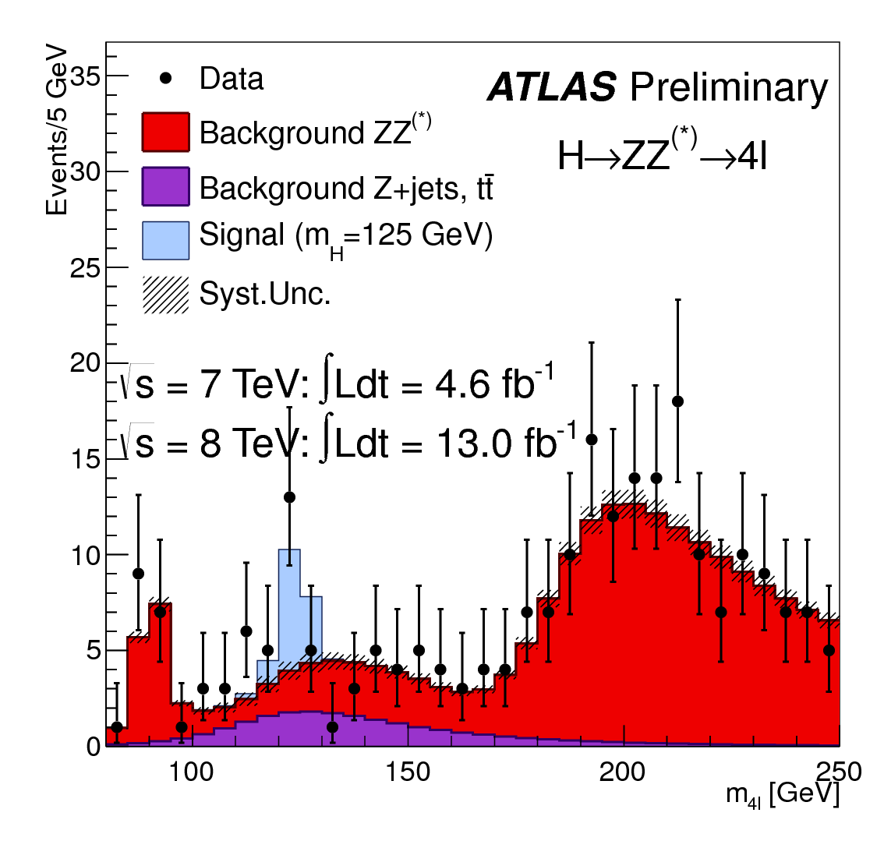
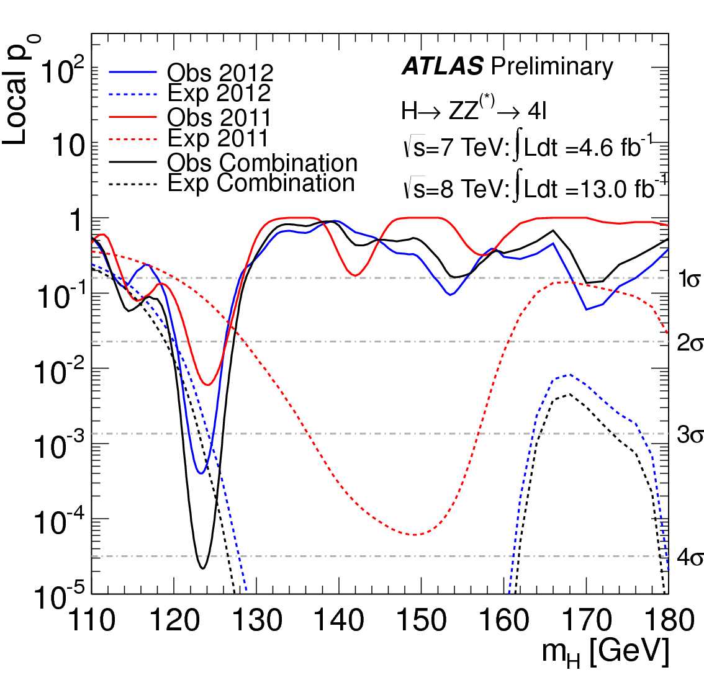
Events in signal region
  observed
  expected background
  expected signal
Observed local sig:
Expected local sig:

Slide 26
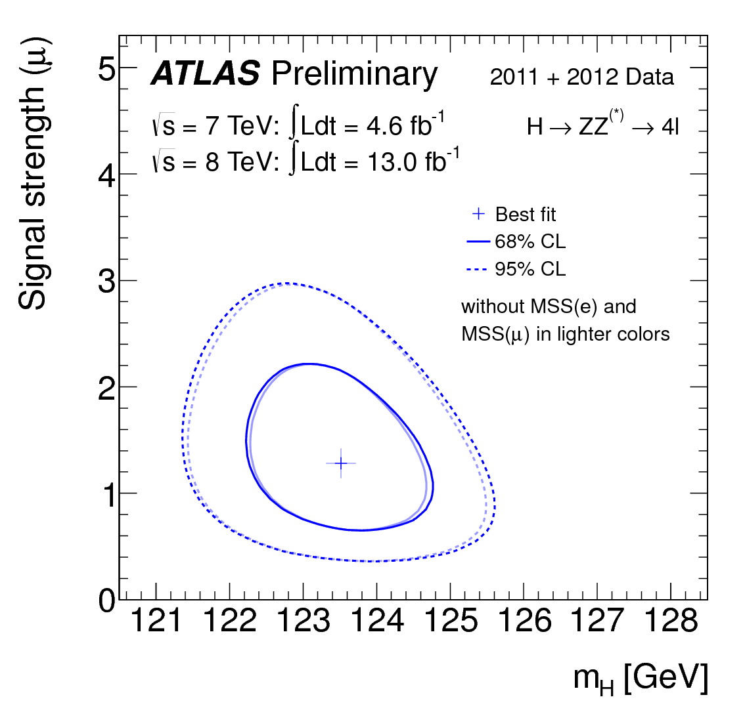

Signal
Mass

Slide 27
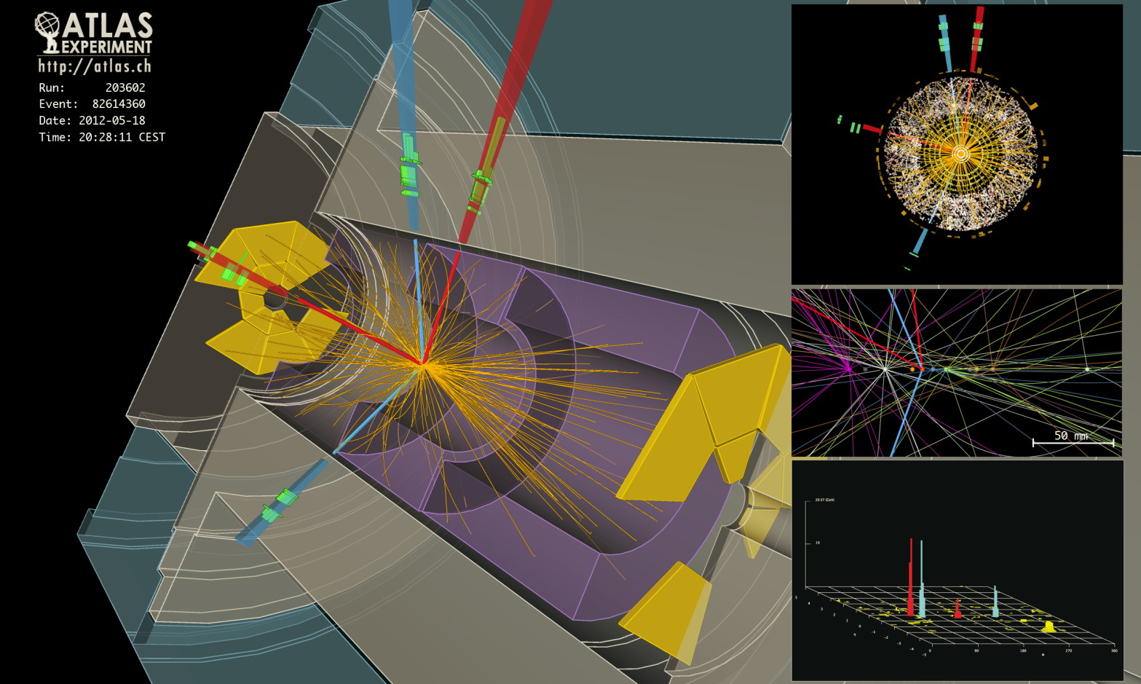
4 electron candidate

Slide 28







at 7 TeV and at 8 TeV
Turned out to be excellent discovery channel.
  precise Higgs mass resolution.
  narrow resonance on smooth background
  robust signal against pileup increase.
Small branching ratio – enormous background.
Excellent electromagnetic calorimetry.
  precise electromagnetic energy resolution.
  excellent discrimination.

Slide 29





Irreducible background
Reducible background
Two tight isolated photons
Analysis split into 12 categories to optimize S/B:
9 categories on basis of conversion – nonconversion.
VBF ( 2 jets with )
VH production low mass di-jet and addition lepton:
    one lepton with

Slide 30

Diphoton sample composition as function of invariant mass.
Signal – Crystal Ball + Gaussian.
Background form from simulation but shape and normalization fitted to data.

Slide 31

diphoton candidate

Slide 32


Systematics:
  photon id efficiency ~ 10%
  energy resolution ~14%
  background param. 0.2 – 4.6 events.
  pileup ~ 4%
  jet energy scale in VBF ~ 10%
Observed local significance
Expected local significance
Signal strength:

Slide 33


Relative signal strength for
(VBF+VH) cf (ggF + ttH)
Systematics dominated by di-photon mass scale.

Slide 34




at 7 TeV and at 8 TeV
Higgs coupling to fermion – charge 1/3.
Largest branching ratio.
Difficult measurement:
  large background from QCD jets
  use VH (background W/Z + jets)
  poor mass resolution cf. two photons
  need high efficiency b-tagging, low fake rate

Slide 35
top
W + jet
Z + jet
Backgrounds:
c-quark, light-quark
diboson simulation
Shapes
Normalization
simulation
data control regions
Except:
multijet data (ABCD)
Control regions:
        top
          1 lepton, require additional jet
          2 lepton reverse cuts
        W/Z + jets – relax 2 b-tag requirement
          b tagging has very different efficiency for b,c, and light quarks.
          different b-tag regions have different flavor content
          “flavor fit” gives norm for different flavors

Slide 36





Illustration of changing flavor content as # b-tags changes.
After normalization from “flavor fit”

Slide 37






0-lepton
1-lepton
2-lepton
Mass distributions for 6 example categories.
Analyze using binned likelihood for all 16 categories

Slide 38


Reality check.
Backgrounds subtracted
      except di-boson.
Simulation normalized to global fit.
Result.
Expected limit (125 GeV) 1.9 x SM.
Observed limit 1.8 x SM.

Slide 39


Slide 40




at 7 TeV and at 8 TeV
Higgs coupling to fermion – charge 1.
Large branching ratio.
Difficult measurement:
  tau decays with missing neutrinos
  indirect mass reconstruction
  poor mass resolution cf. two photons
  tau identification more difficult
Boosted Higgs - high tau decay products.
  better signal discrimination
  better mass determination
Missing Mass Calculator
  better resolution: 13% to 20%
  reduced resolution tails
  correct position of mass peak

Slide 41


Complex analysis
Three final states
11 subcategories – different cuts:
  2-jet VBF, boosted, 2-jet VH, 1-jet, 0-jet
  VBF, boosted, 1-jet, 0-jet
  VBF, boosted
  classify by
  Tau ID by Boosted Decision Trees.
Tau mass reconstruction – missing neutrinos:
Colinear – neutrinos in direction of visible decay products
  breaks down for back-to-back config
  long mass resolution tails
Missing Mass Calculator:
  probability distributions of decay products from simulation
  require observed decay products and to come from “most probable” tau kinematics.

Slide 42

Main background irreducible.
  remove muons from in data.
  replace by taus generated by TAUOLA.
  only taus from simulation
  jets, underlying event, pileup from data.
QCD and W+jets:
  same-sign and template fits to track multiplicity
Top, Z decays to electrons and muons.
  simulation normalized to control regions
Diboson background
  simulation

Slide 43



Mass distributions from “VBF” sample.
MMC mass resolution key to analysis

Slide 44


Expected local significance:
Observed
Sensitivity comes from ggF

Slide 45

VBF event

Slide 46


Combination of ZZ and γγ Channels
Precise mass resolutions
Largely uncorrelated systematics
simultaneously consistent
common mass profiled
mass difference
corresponds to

Slide 47


Combination of all Channels
mass scale uncertainties included
observed local
expected local
combined signal strength
probability of all 5 channels being compatible: 13%

Slide 48




events within of mass peak

Slide 49

is fraction of gg
Expected exclusion of : 97%
Observed : 91%

Slide 50

Use events in
Study
Two approaches: BDT, MELA
Boosted Decision Tree
For train on
For spin 2 add
Matrix Element Likelihood Ratio
Calculate prob. of each for each event
Discriminant is ratio PDF for one to that for both

Slide 51




Spin 2
Expected exclusion: 80% CL
Observed : 85% CL
Consistent with spin 0,

Slide 52




Expected exclusion: 96% CL
Observed : 99% CL
preferred at

Slide 53
Outlook for 2013
Analysis of full 2011 – 2013 data set
  Measure rates in various new channels.
  Improve several channels.
  Improve Spin/CP measurements.
  Improve mass measurement.
  Extend search for non-SM Higgs

Slide 54
Conclusions
ATLAS observation of new boson confirmed at .
Rapid progress in .
Rates compatible with Standard Model, at 13% prob.
Spin and Parity compatible with .

Slide 55
References
Most Recent analyses
ATLAS-CONF-2012-158
ATLAS-CONF-2012-169
ATLAS-CONF-2012-168
ATLAS-CONF-2012-161
ATLAS-CONF-2012-160
ATLAS-CONF-2012-162, ATLAS-CONF-2012-170

